Slide 1
Note: I do not own the rights to the pictures or organizers. Please look at the links in order to go to the appropriate webpages.
“Engaging English Learners within a Sheltered Instruction Classroom and School Community“
M. Annette Bicksler
North Plainfield HS
Science Teacher/Teacher Leader/ESL Coach

Slide 2
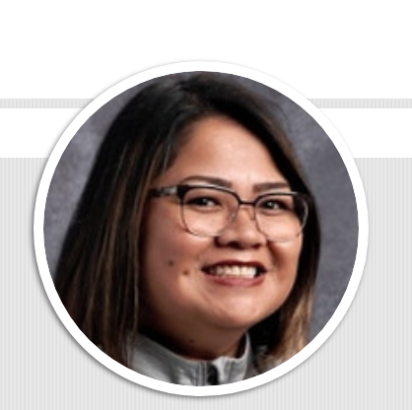
M. Annette Bicksler
M. Ed in Science Education
(GSE- Rutgers University)
& Curriculum and Learning -Bilingual/ESL
(William Paterson University)
PATSEL recipient
NPHS Science Teacher (+15 years)
Teacher Leader
ESL Coach
Contact Info: annette_bicksler@nplainfield.org
Notes:
1-2 minutes

Slide 3

3366 students (Total)
1567 Language Minority Students
407 (ESL students as of 10/13/17)
27 (languages)
English, Spanish, Arabic, Turkish, & Urdu

Slide 4
Grades K - 5: English as a Second Language (ESL)
ESL is an intensive English program for those students whose first language is other than English and whose proficiency is still developing. Students in this program are part of a mainstream classroom throughout the day, and receive additional instruction from an ESL teacher, either in a small group setting or within their mainstream classroom. Instruction in this program is in English only and focuses on Basic Interpersonal Communication Skills and Cognitive Academic Language.
Grades 6-12: English as a Second Language (ESL)
In Grades 6-12, there are levels of ESL programming, in which a student may be placed, based in his/her English Language Proficiency. Content area material is used as a resource through which ESL techniques and strategies are infused. For ESL identified students, ESL classes, satisfy the Language Arts High School Graduation Requirement.
Notes:
North Plainfield ESL program description

Slide 5
What is my role as a sheltered instruction content teacher?
ensure that content is comprehensible for my students by
  incorporating language objectives with content objectives
  employing strategies the enable language development
  building on the student’s prior knowledge and background
provide a safe and equitable environment
provide opportunities to participate and be part of the school community

Slide 6
Learning & Language Goals
Use strategies to engage and enable ELs to communicate their understanding about the world around them
Make connections between experiences as advocates and teachers among professionals
Discuss & collaborate among group members
Listen to members of your group
Ask questions using wh- questions
Use adjectives when making observations
to
Notes:
1-2 minutes
Differences between learning and language goals
Why it is important to think of them ahead of time
What is a strategy? What is its purpose?

Slide 7

My Why….

Slide 8
“ The day that I decided to move to a new country had been challenging for me.”
My “WHY?”
Brandon S.
“ Also, coming to this country and confronting the reality that Latin American people are not treated well for speak another language.”
“The first year here, I wasn’t comfortable because I had left people who are important to me behind, like my grandma that raised me since I was three to fifteen years old.”
“My first year in North Plainfield High school, I felt like a kindergartener when I started. It was like I didn’t have the knowledge because I couldn’t express myself verbally. I was ashamed because I was already 15 years old and I was a Freshman.”
“Sometimes I used to think that I would not find a place where I belong a place where I can feel comfortable and express myself without being judged.”

Slide 9

“For instance, I remember when I was in Algebra class, the teacher was teaching a specific topic that I knew, and I had knowledge of the content, but I didn’t have the language to express it. Some students looked at me like I didn't know anything but I did. I felt bad, heartbroken, disappointed, and frustrated with myself because I used to think that I wouldn’t be able to learn English. However, as I started learning more English I felt like I was growing as a person.

Slide 10
What is your why?
Notes:
Speed Dating Activity

Slide 11
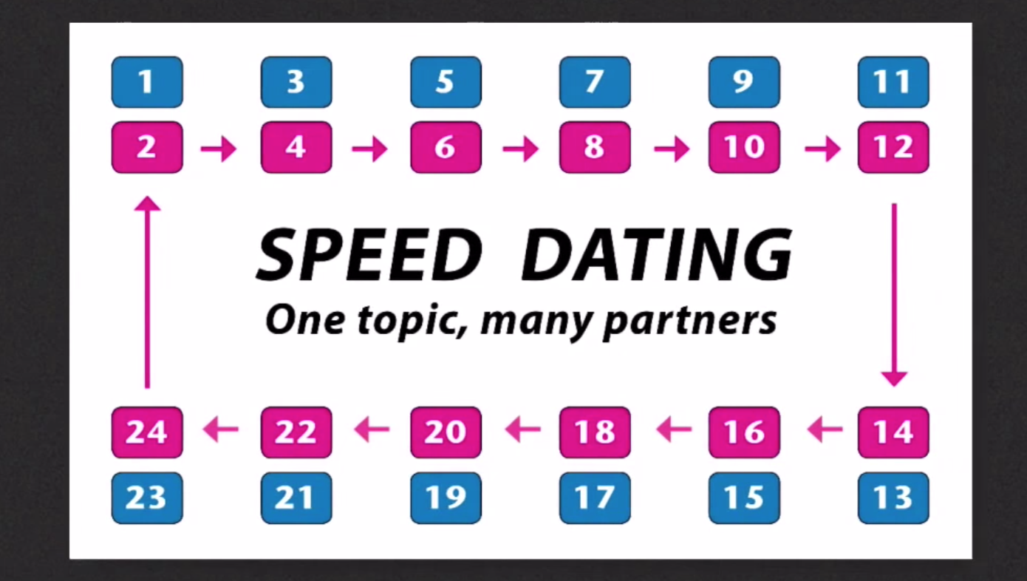
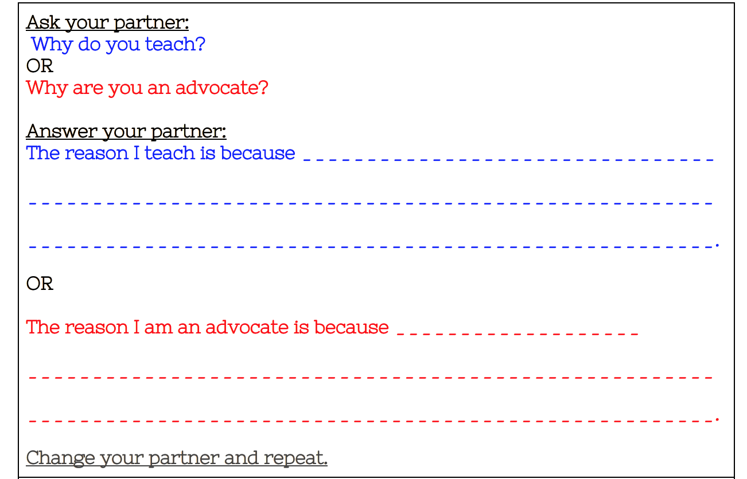

Speed Dating
Notes:
Speed Dating Activity

Slide 12


Slide 13
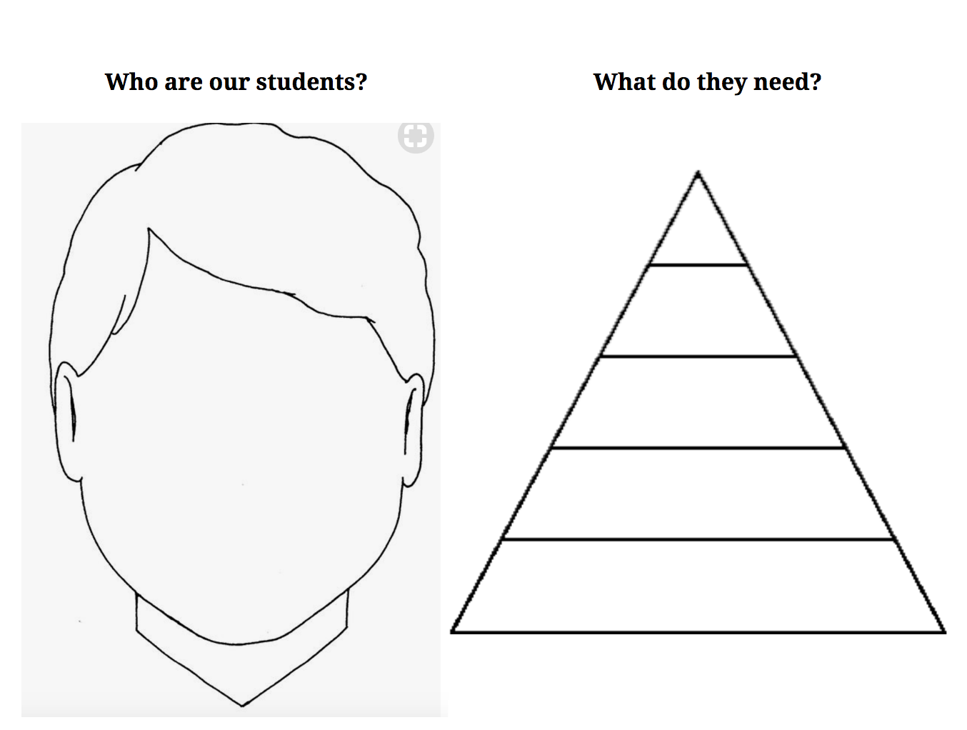
Notes:
https://docs.google.com/document/d/1QKvUeFnMC25dBt3onsIFtg3T07R4qdyuPN4uWo9uiJs/edit?usp=sharing -
Graphic Organizer: “Who are our students? What do they need?”

Slide 14
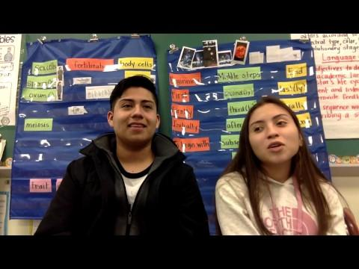
Getting to Know Our Students

Slide 15

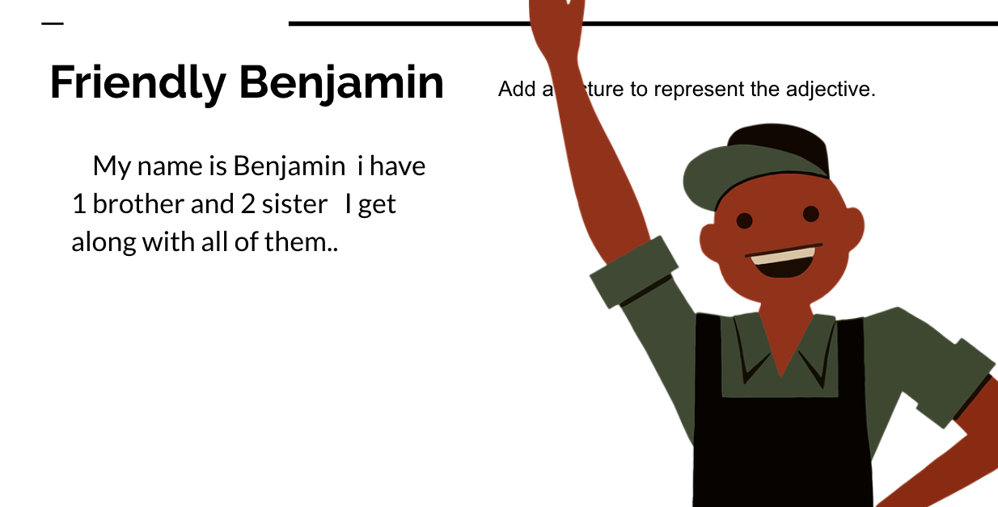
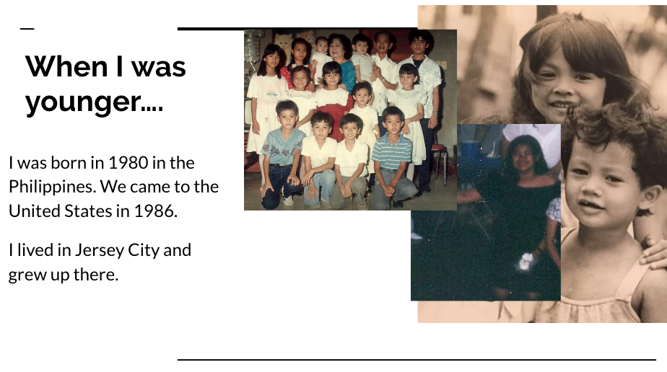

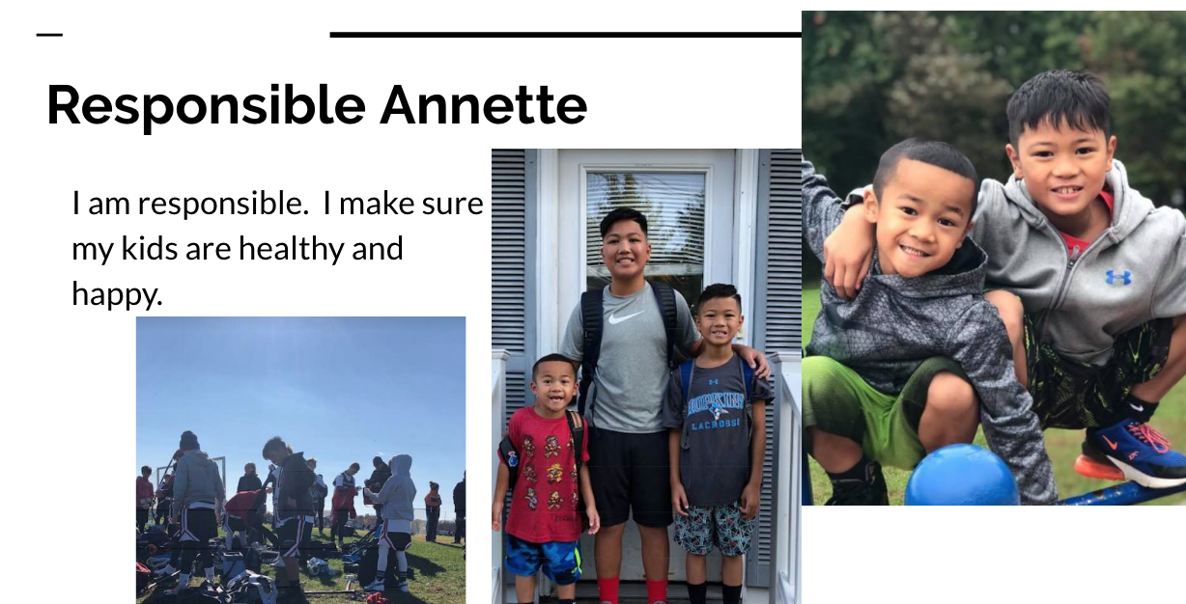
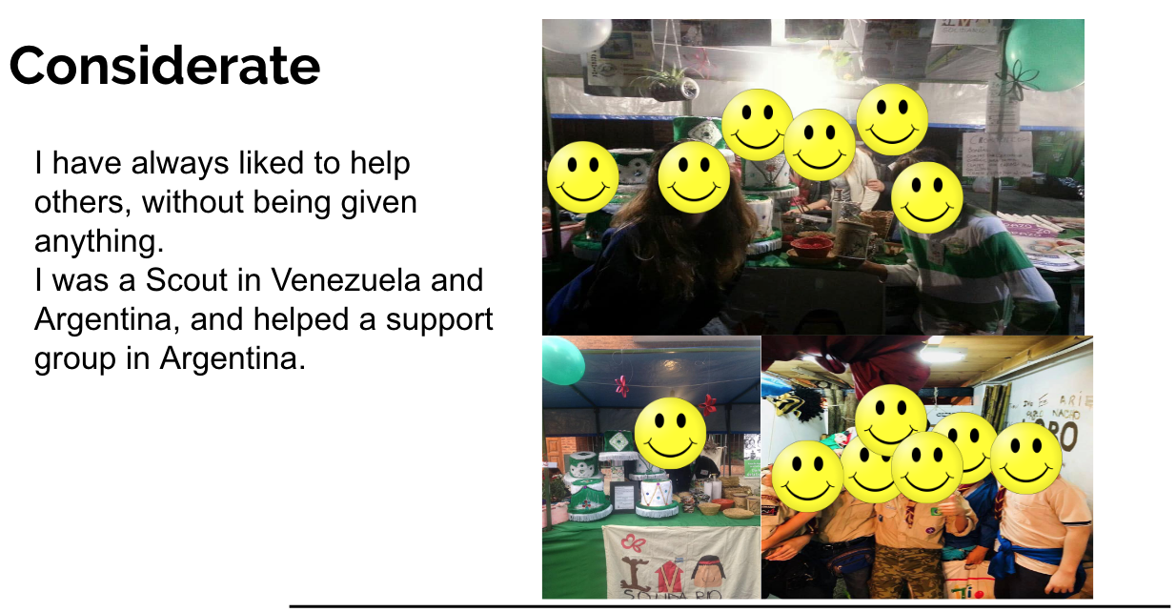
GETTING TO KNOW YOUR STUDENTS...
STUDENT TEMPLATE
TEACHER MODEL

Slide 16
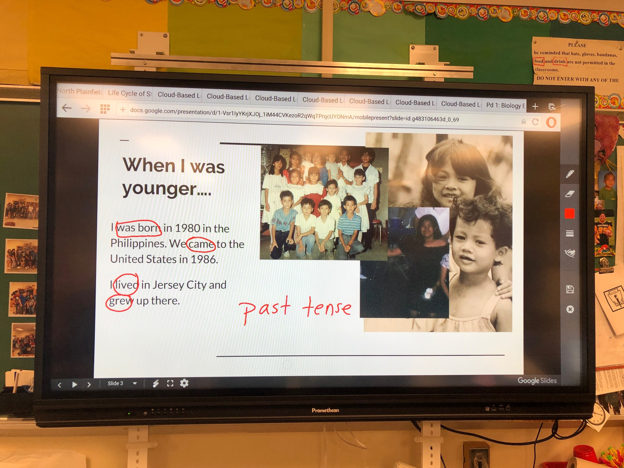

Slide 17
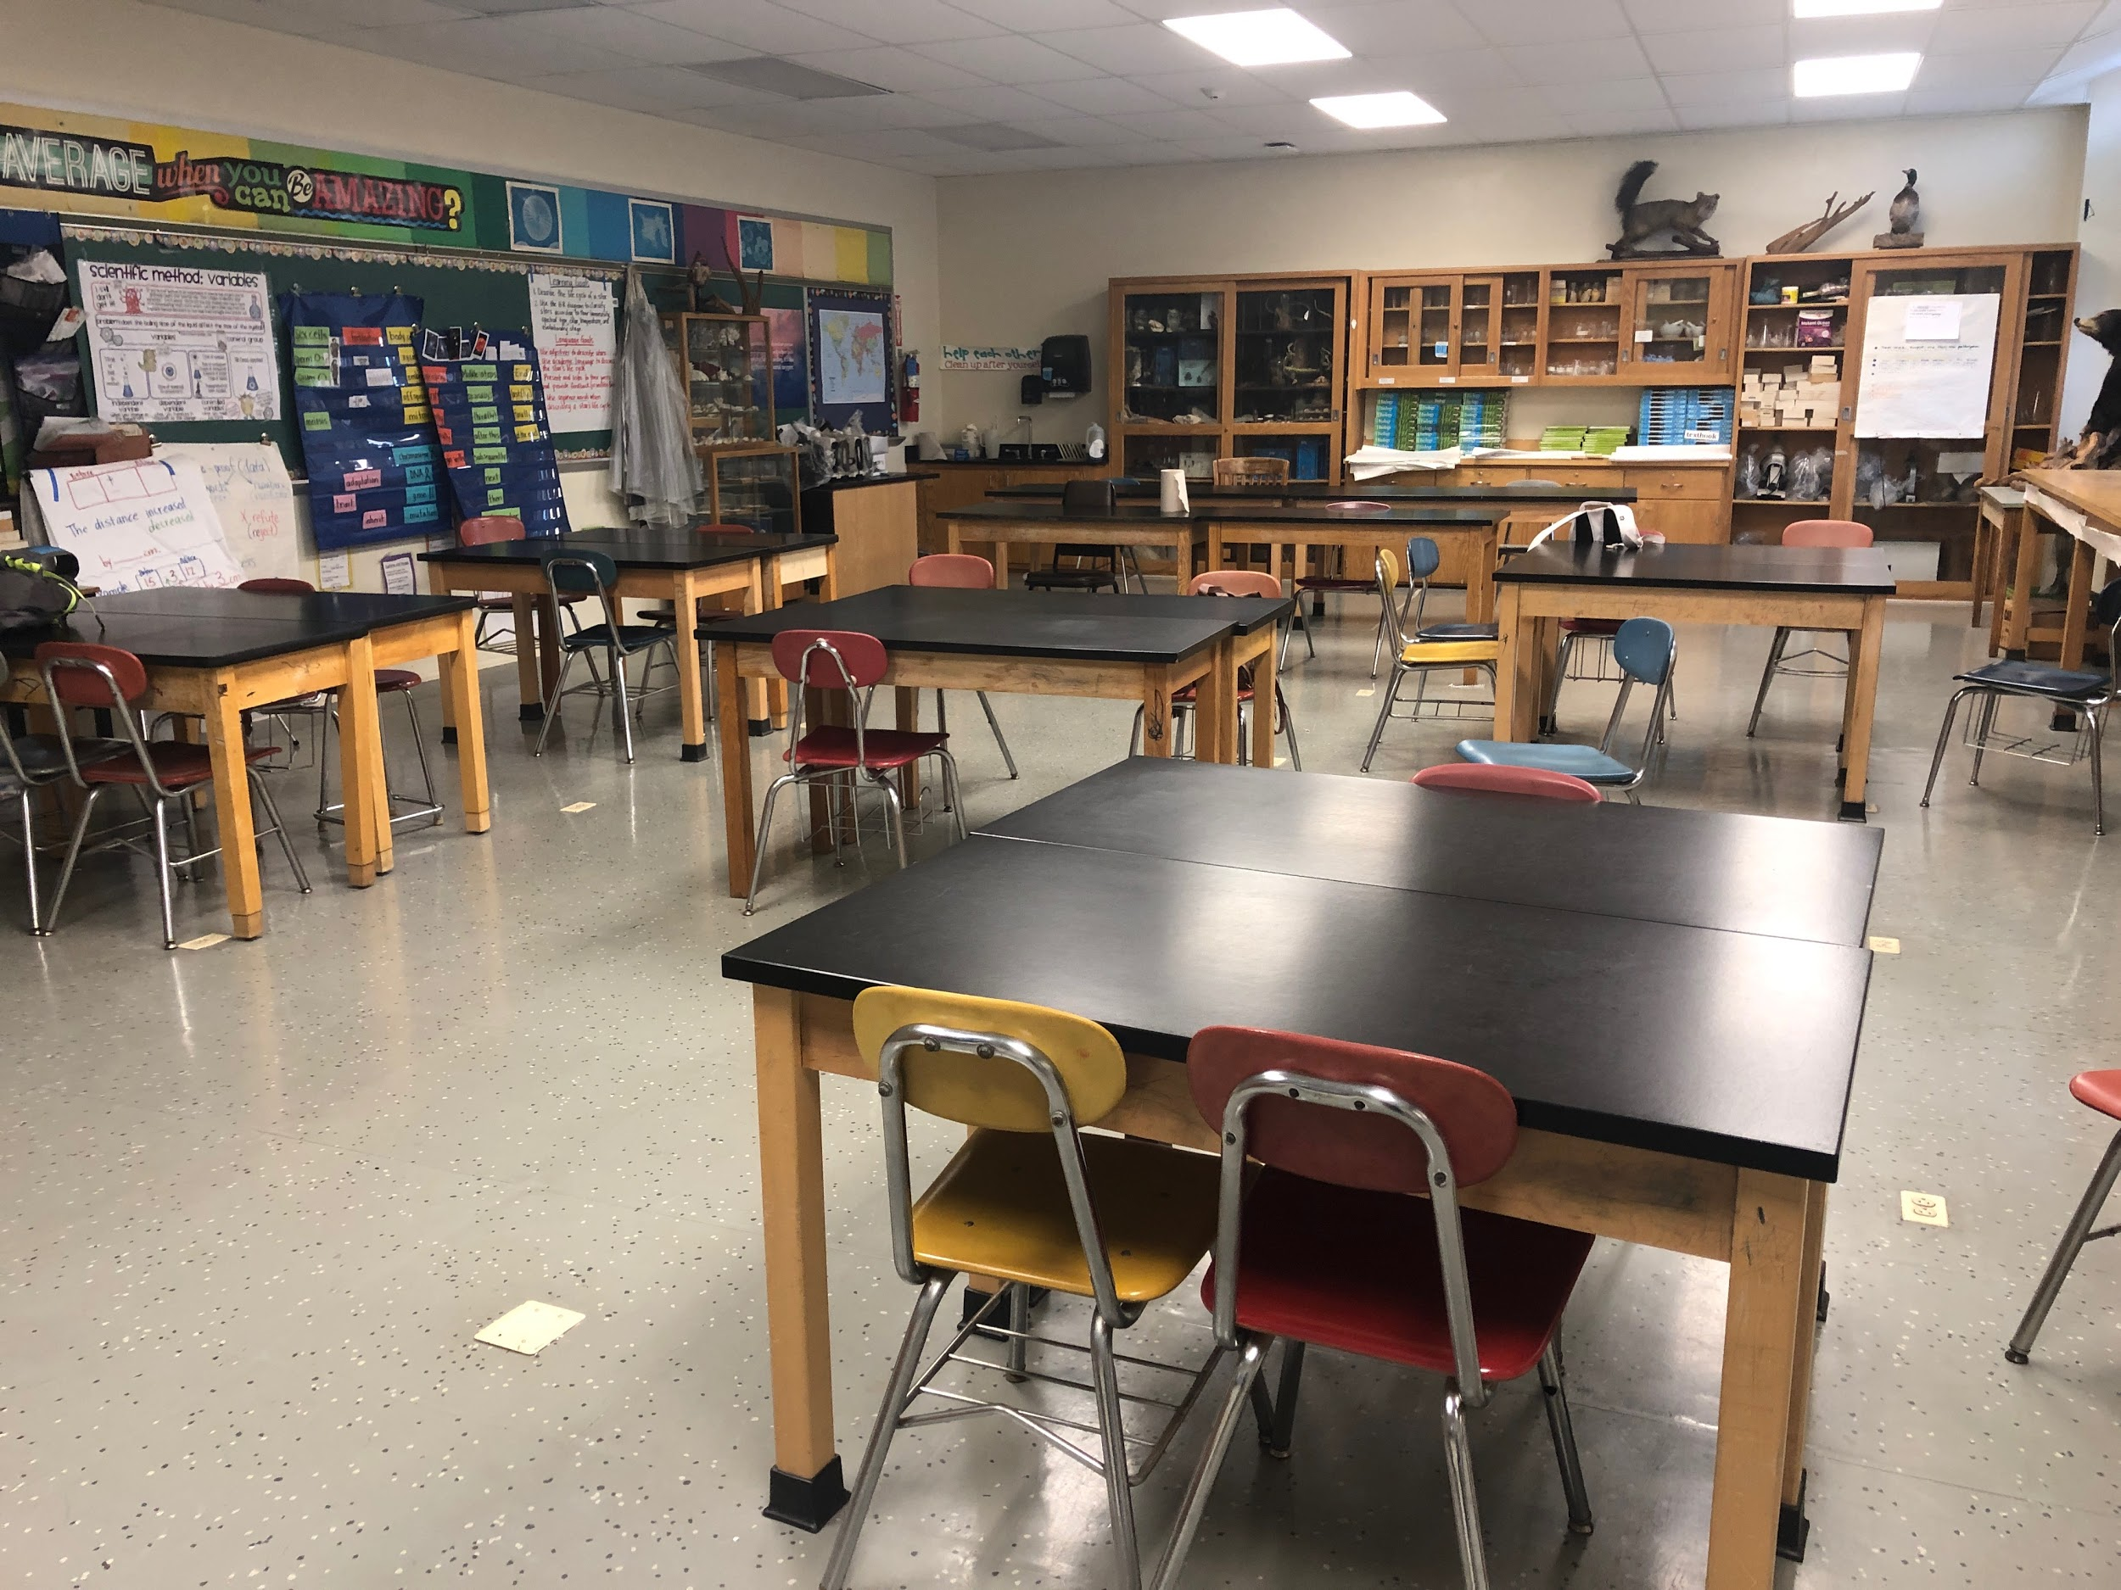
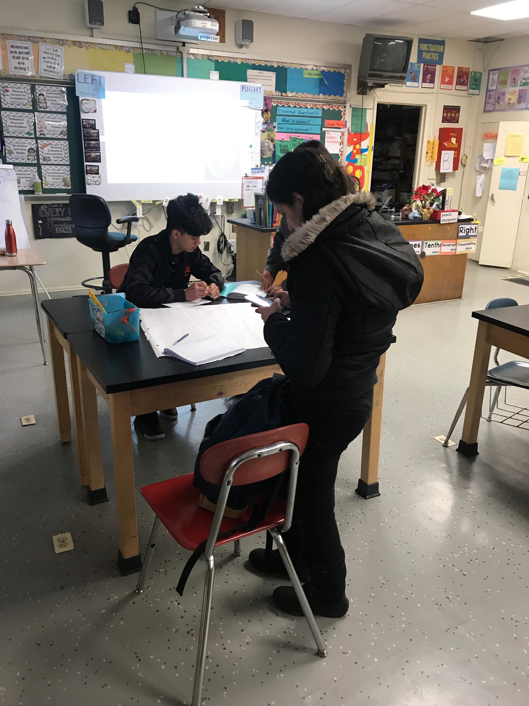

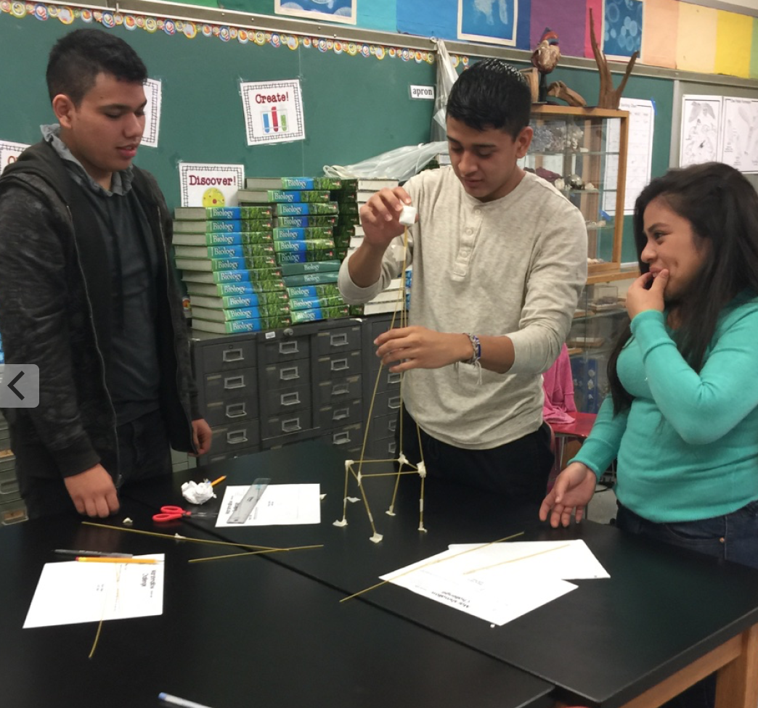
Instructional Supports:
Classroom Environment
Notes:
Lab tables are grouped together to facilitate classroom discussion - can be moved if necessary, labels on objects around the room, a place for everything

Slide 18
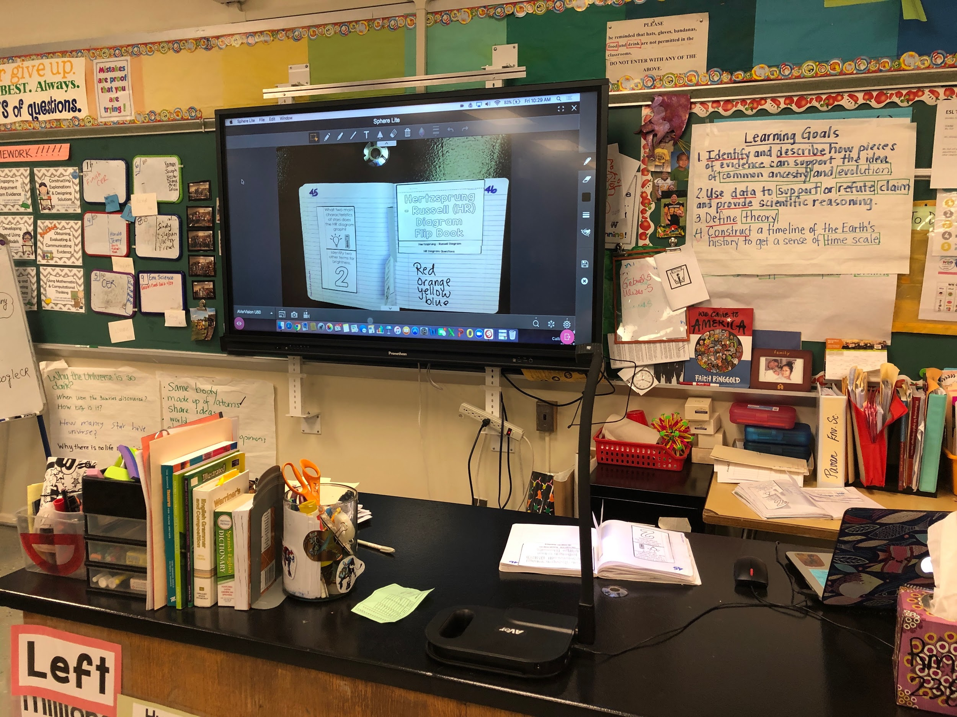
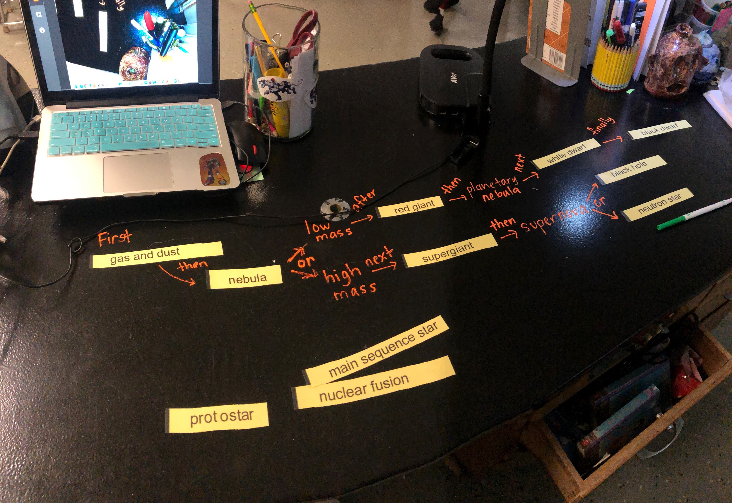
Instructional Supports:
Document Reader

Slide 19
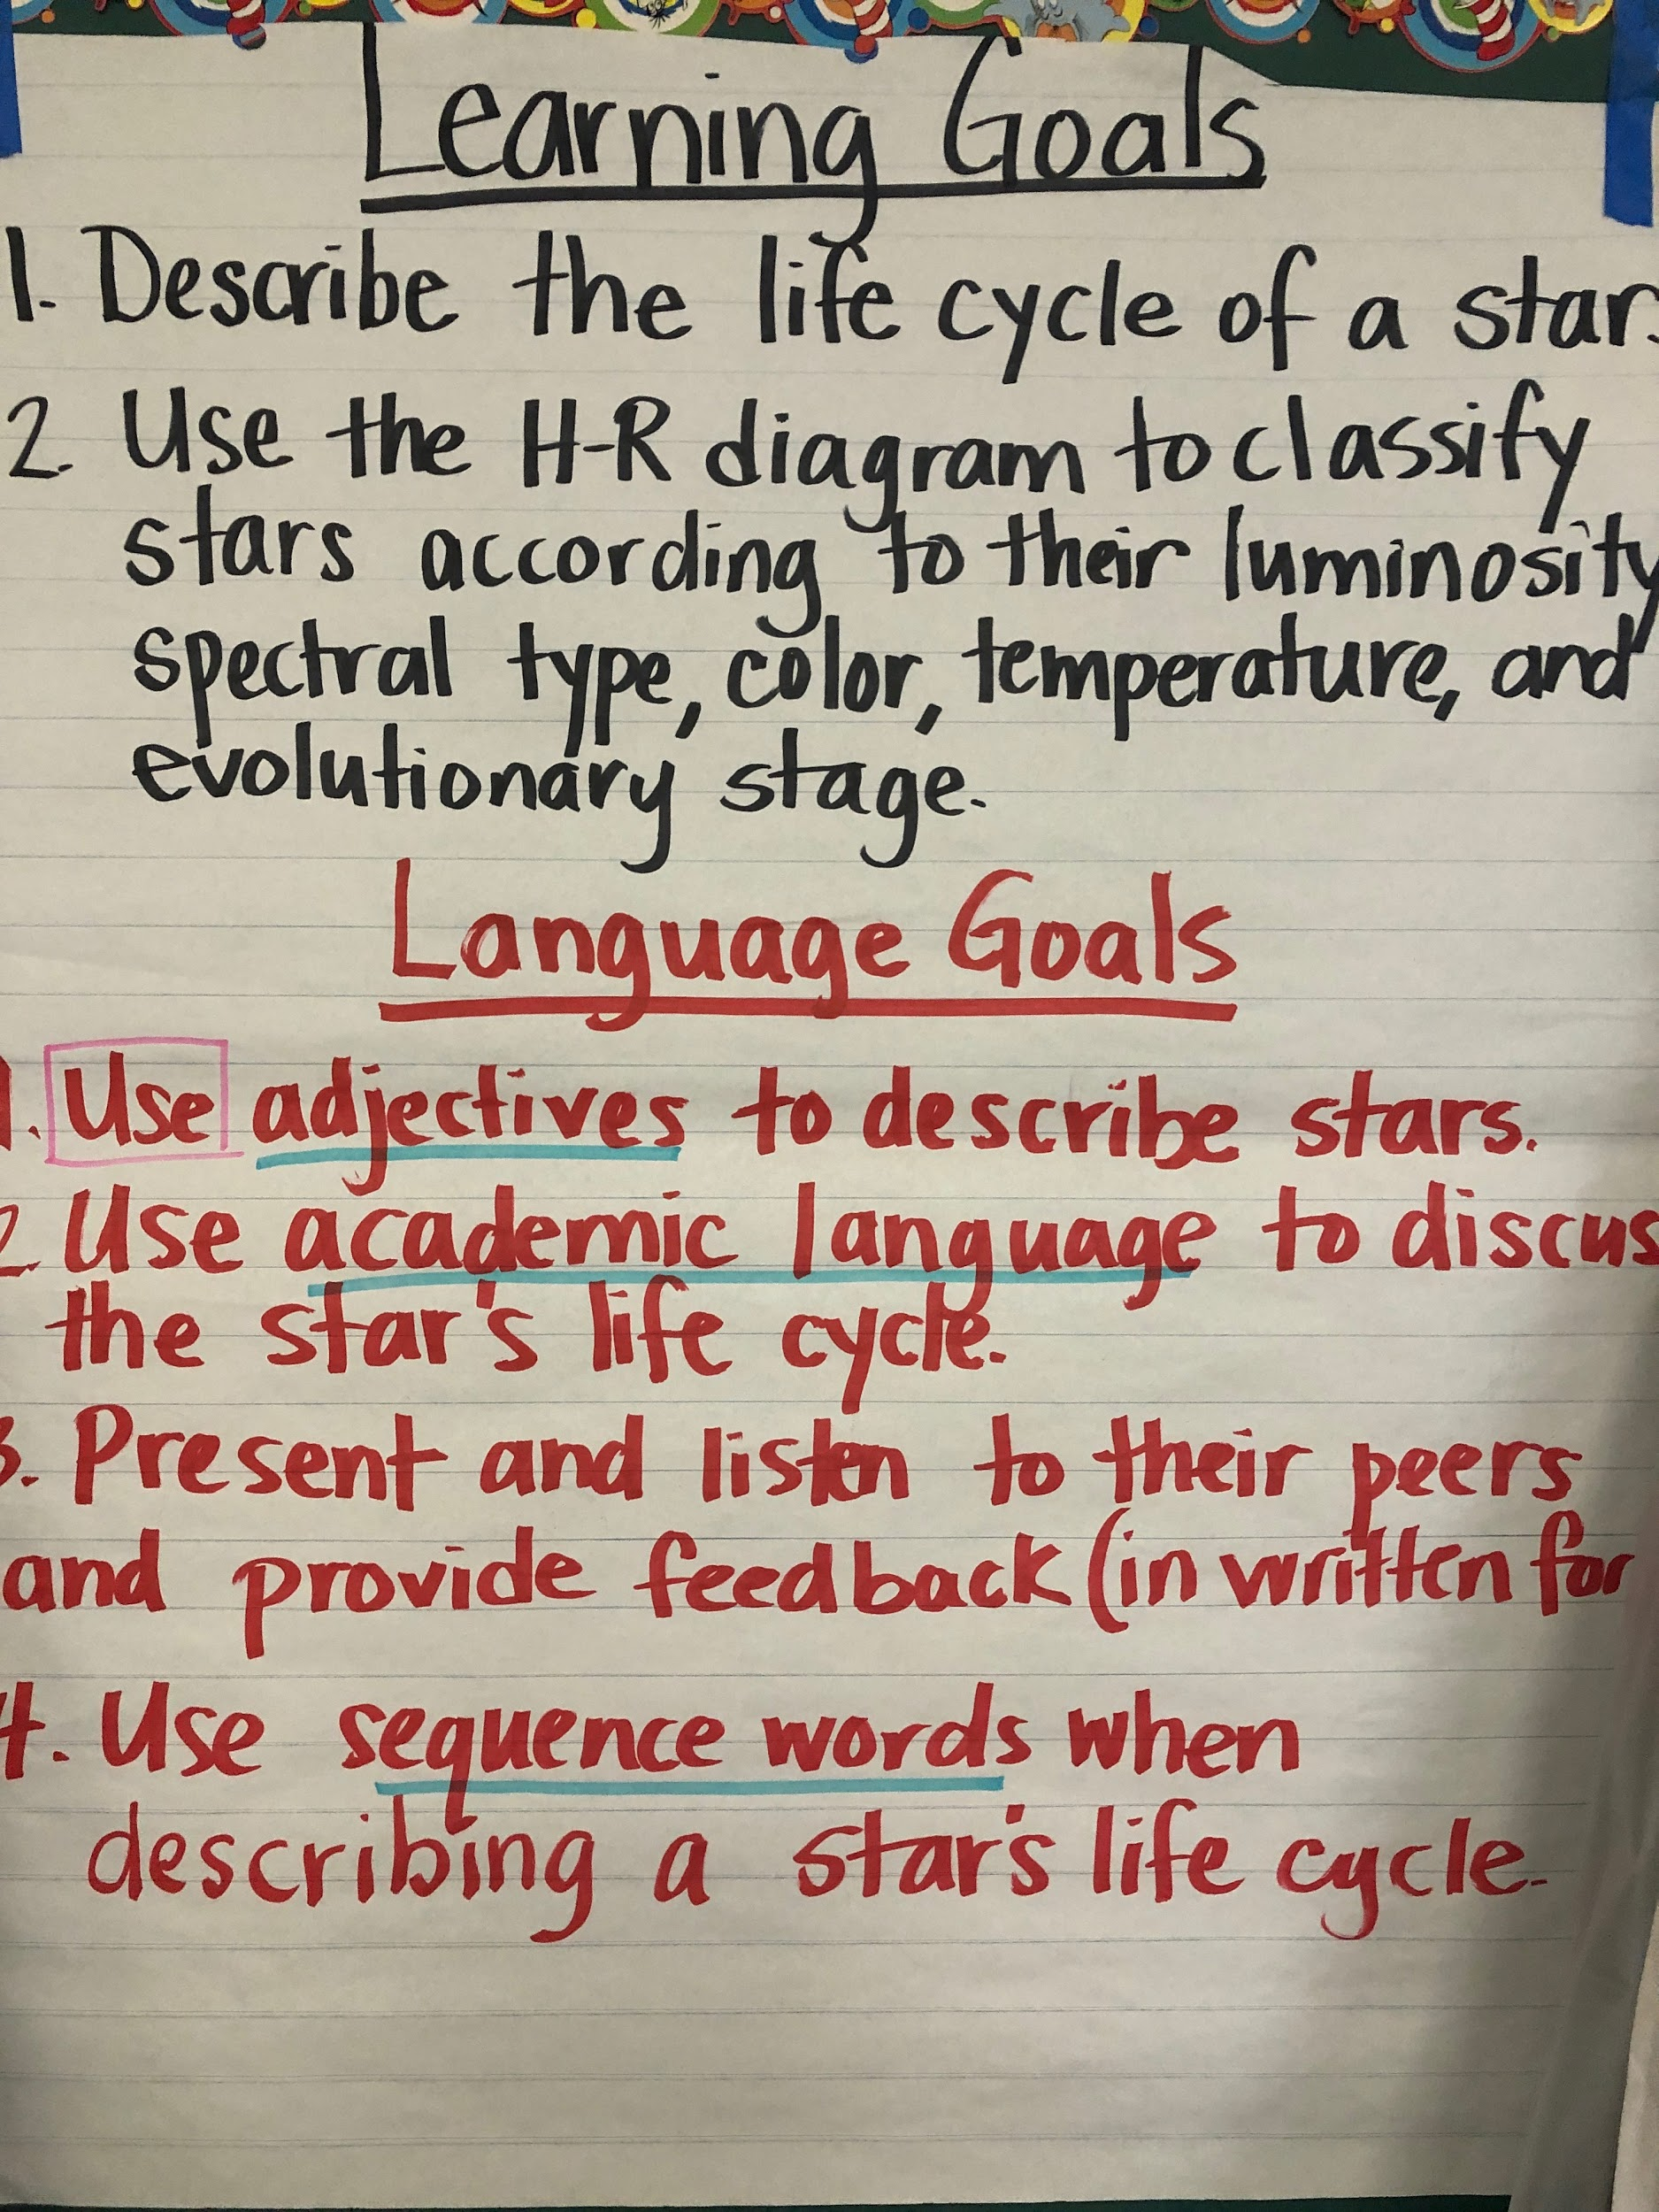
Lesson & Language Objectives

Slide 20
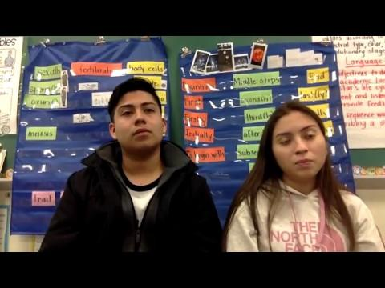
VOCABULARY:
MAKING THE CONNECTION

Slide 21
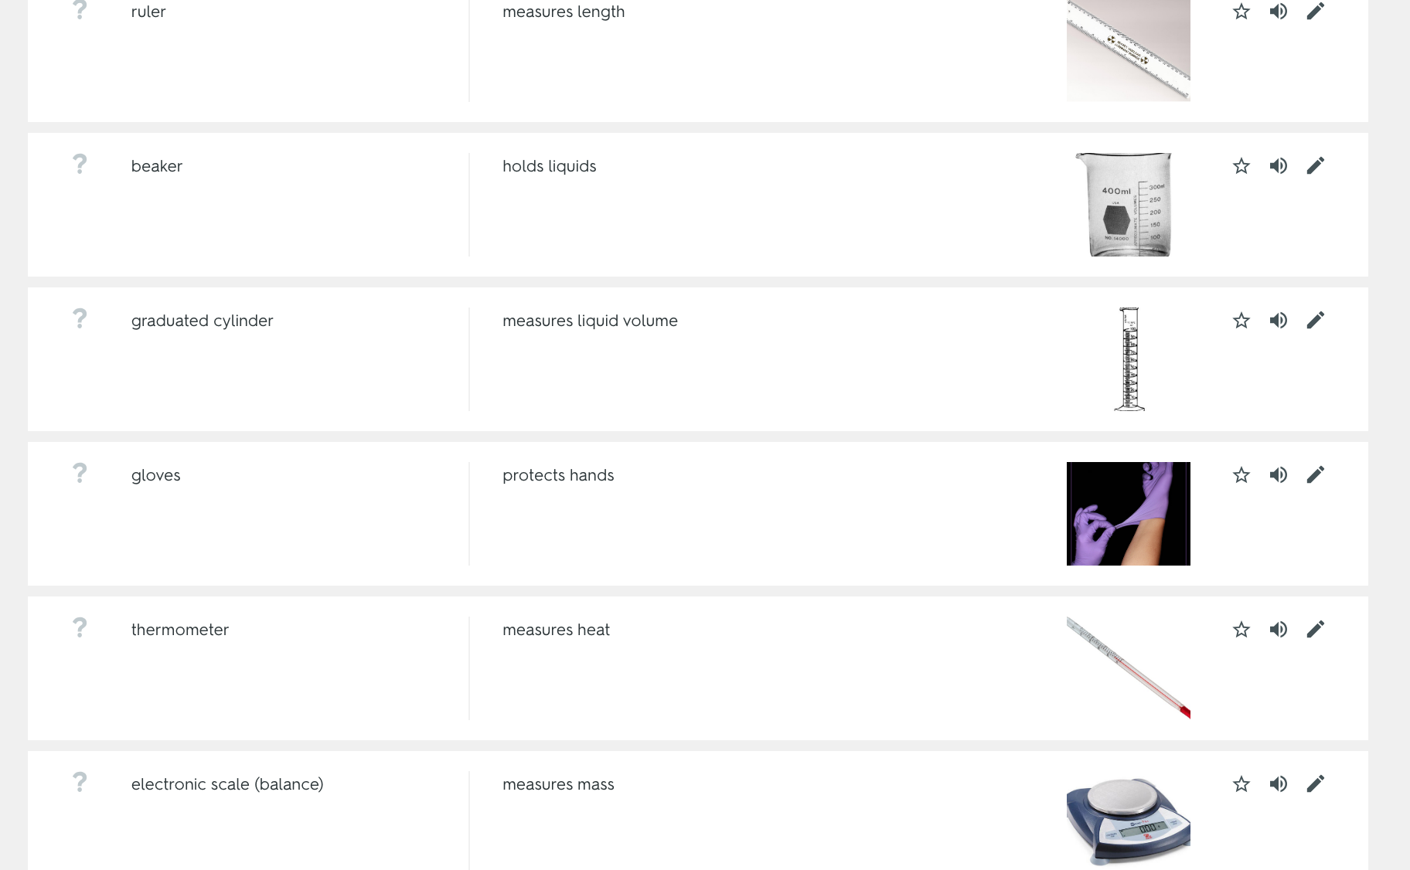
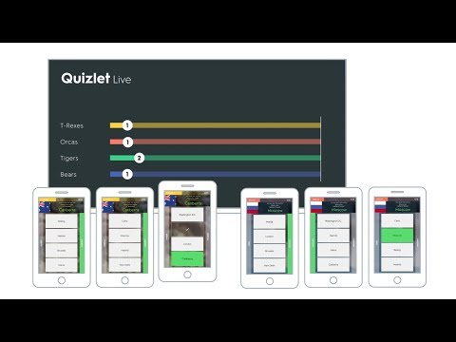
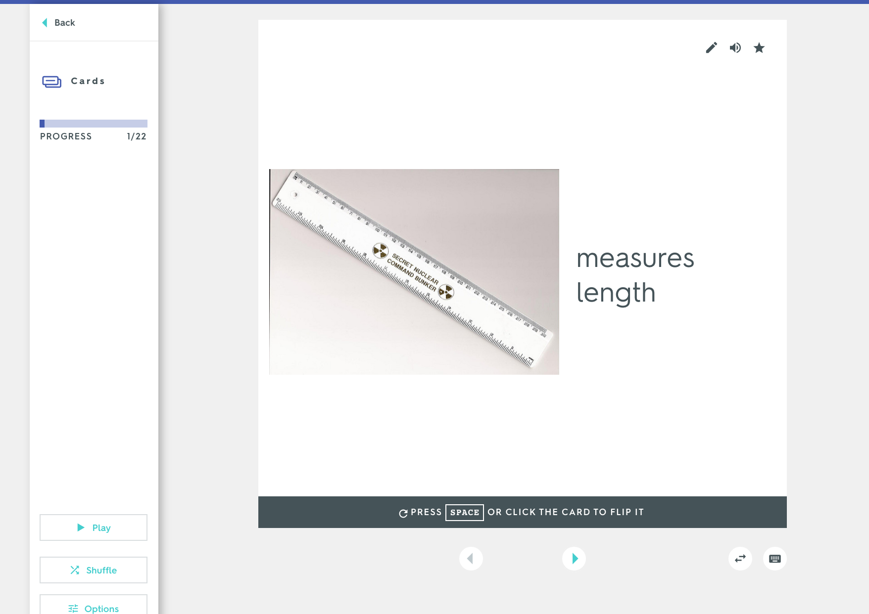
QUIZLET
“Competition, Collaboration, Engagement”
Vocabulary

Slide 22
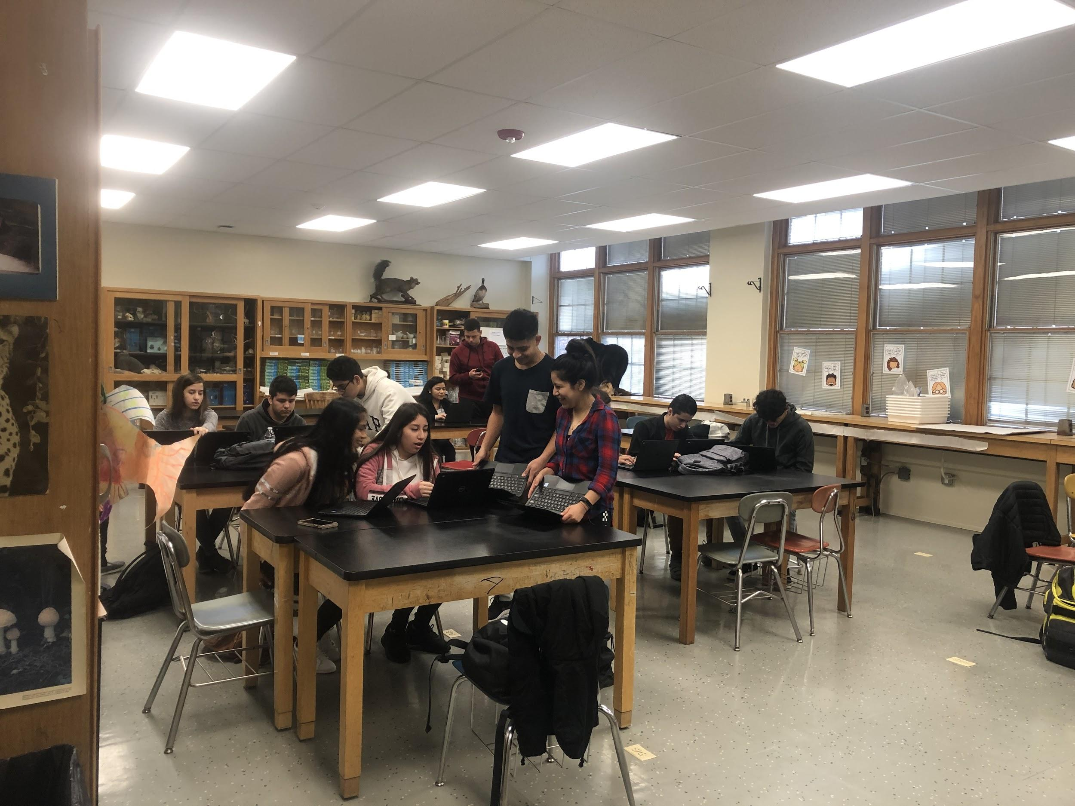

Vocabulary

Slide 23
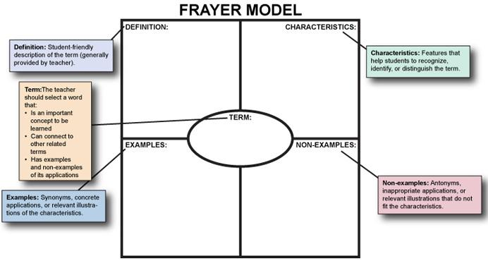
Vocabulary
Notes:
USING THE FRAYER MODEL AND ONLINE DICTIONARY LIKE WEBSTER-MERRIAM FOR ELS

Slide 24
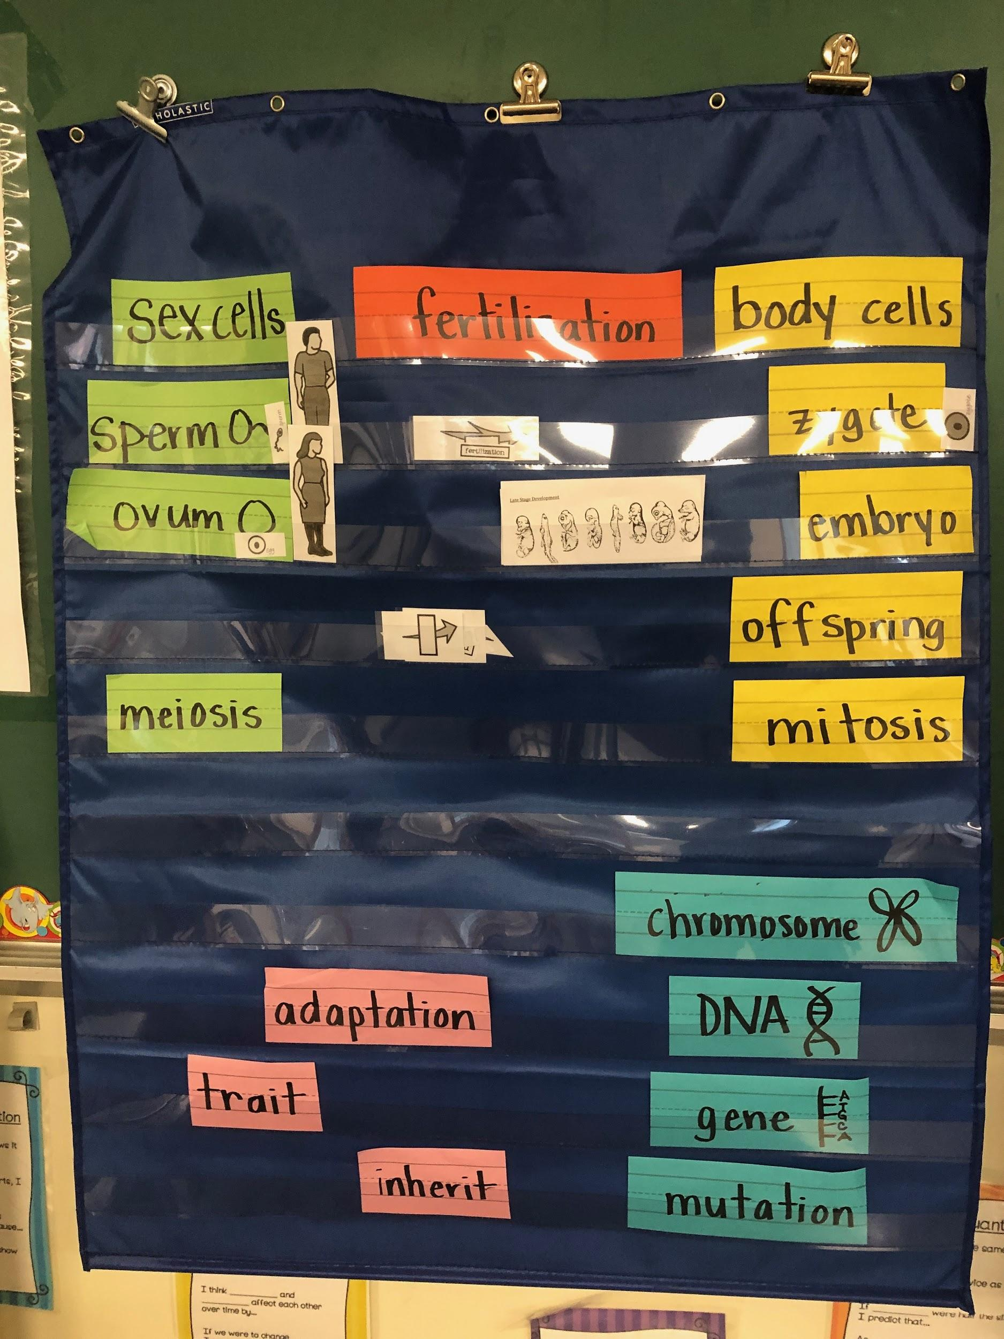
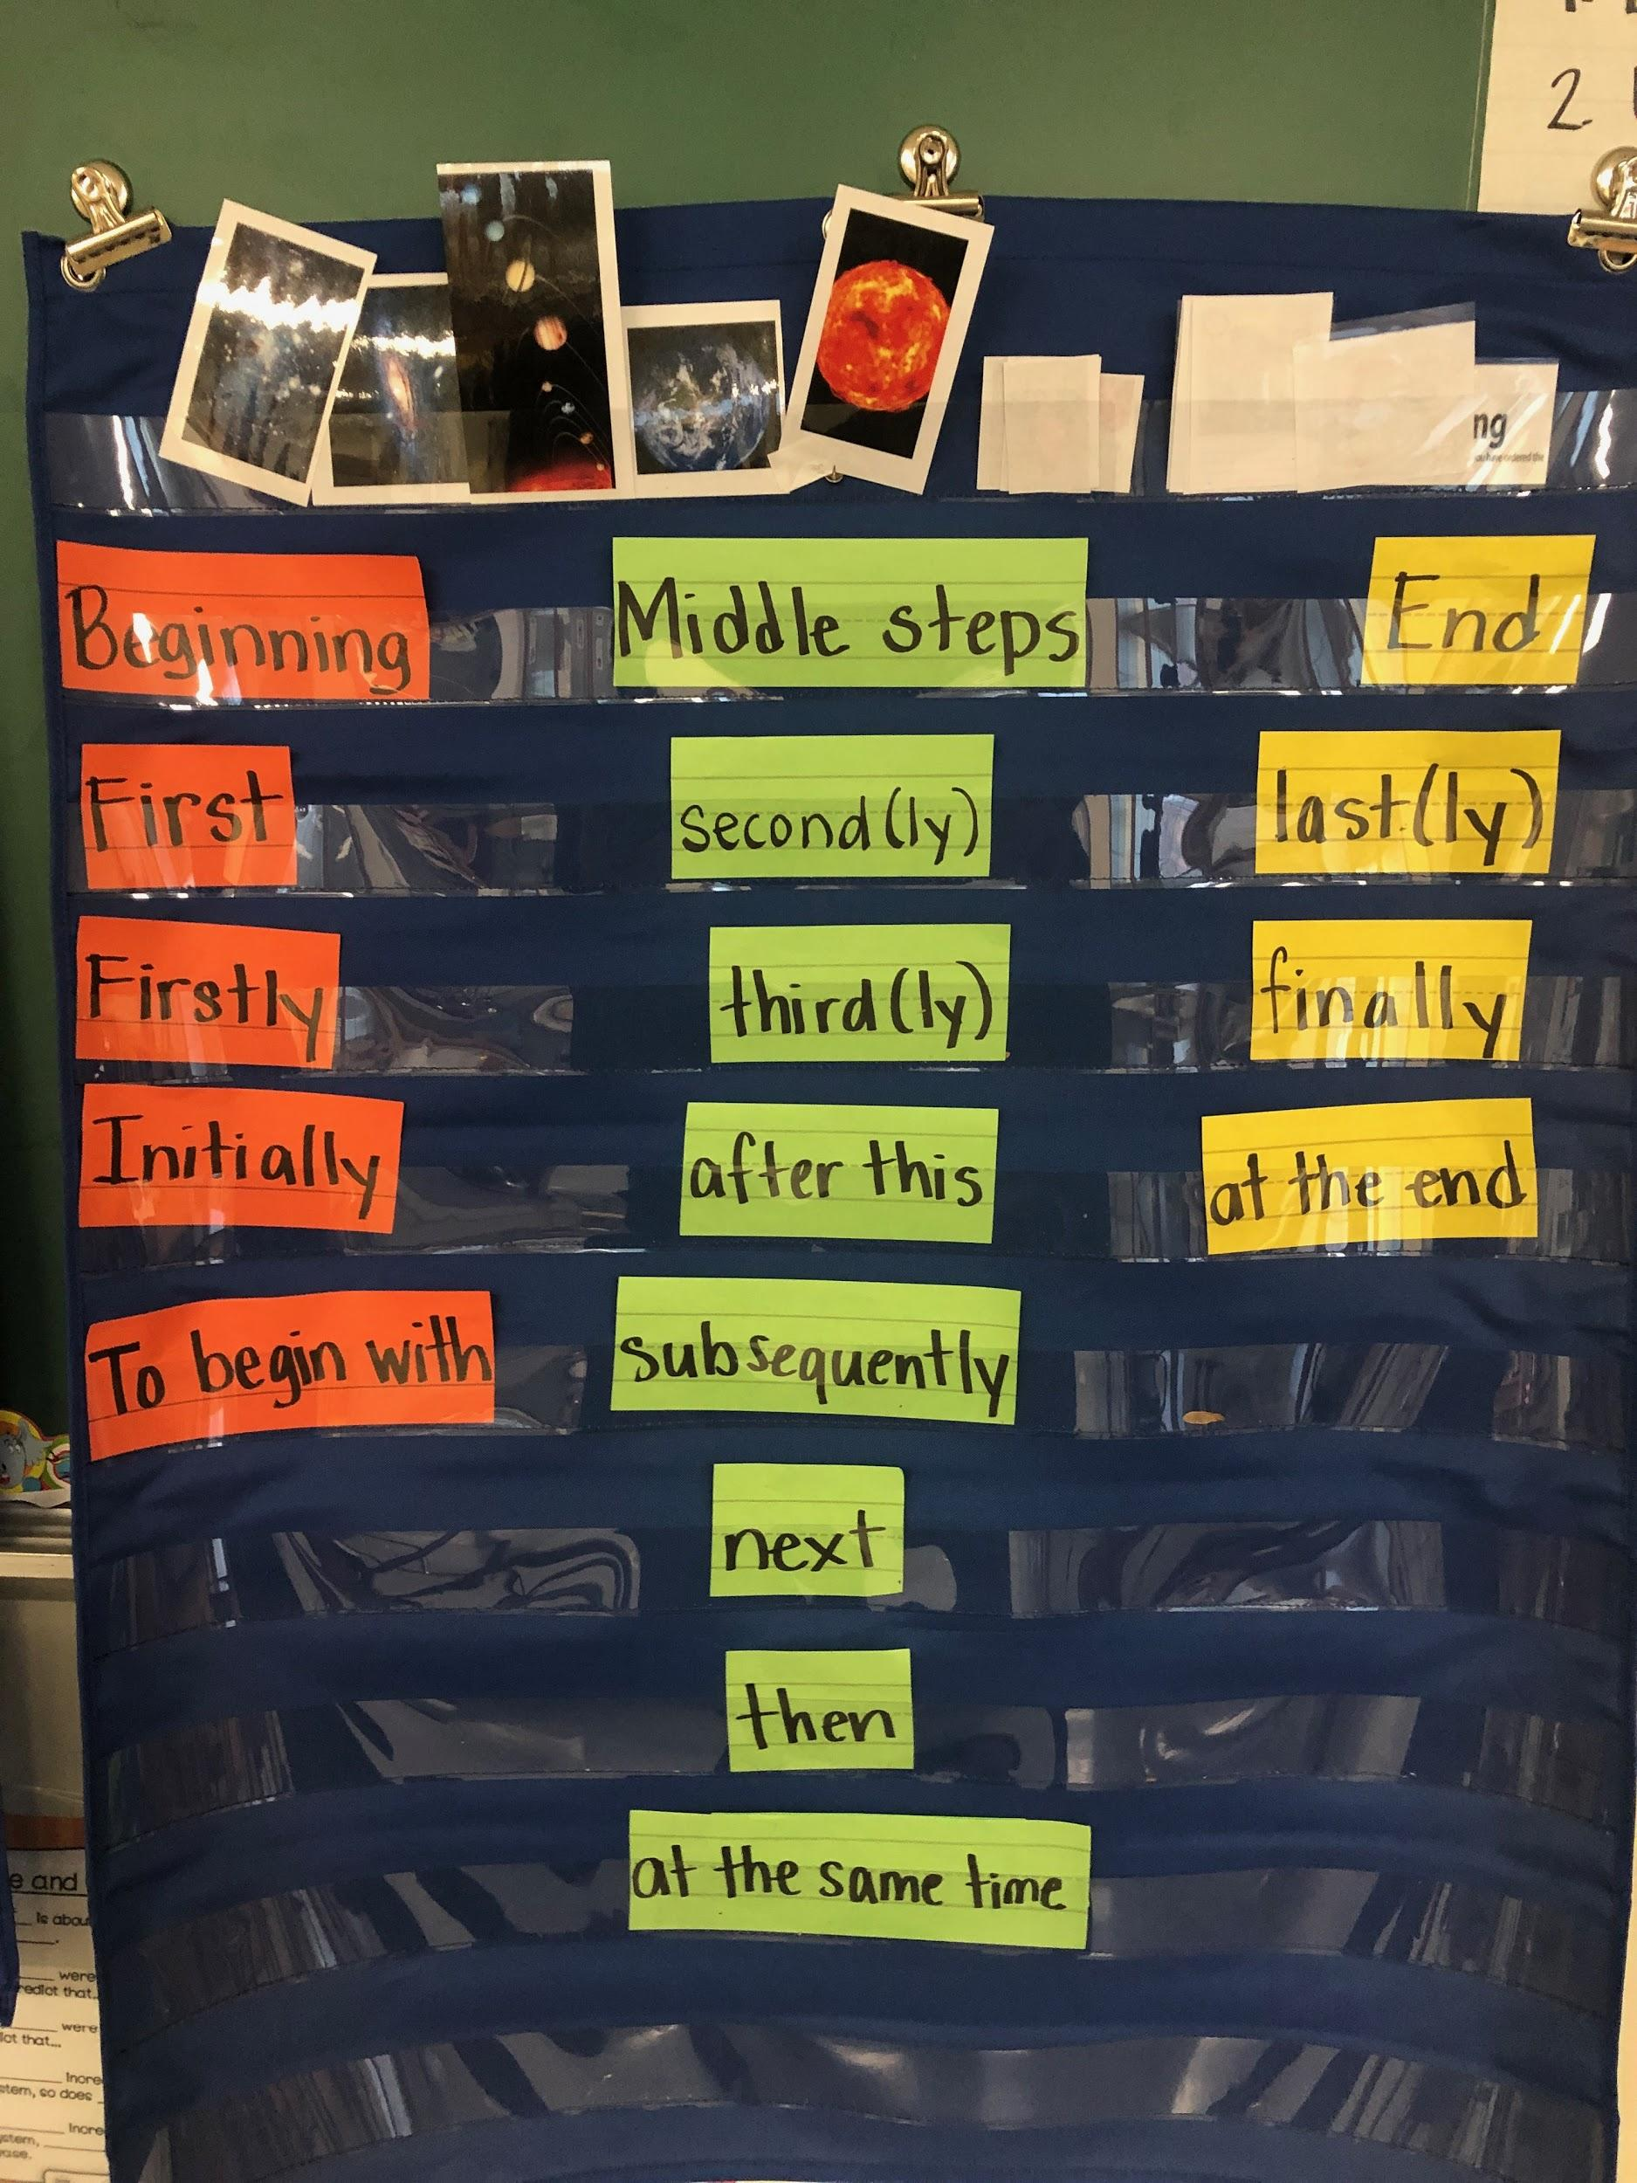
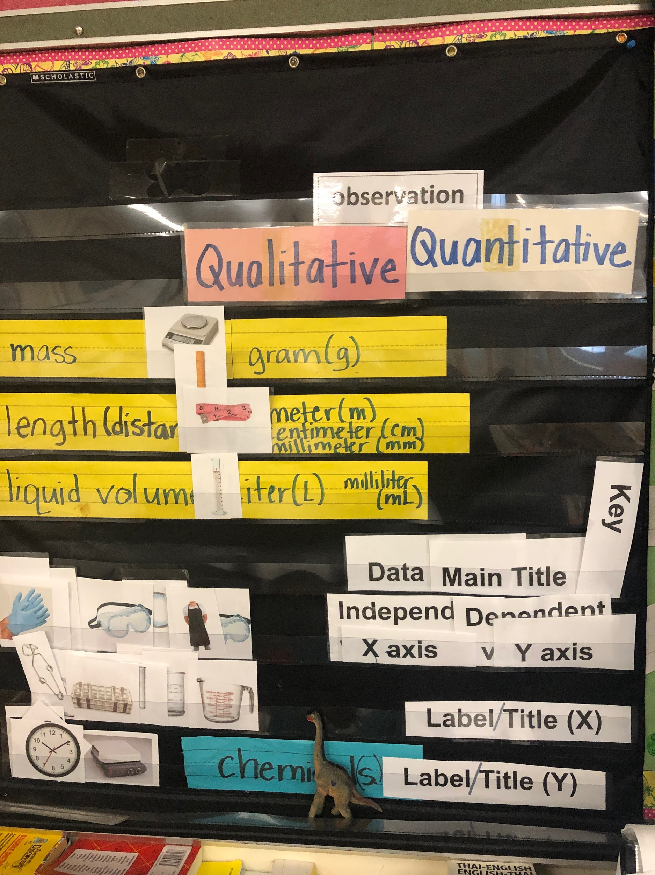
Instructional Supports:
Vocabulary Walls
Vocabulary

Slide 25

Guess the object?
Ask me a question....
Notes:
wh- question sentence frames

Slide 26


Slide 27
Guess the object?
Ask me a question....

Slide 28


Slide 29
Guess the object?
Ask me a question....

Slide 30


Slide 31
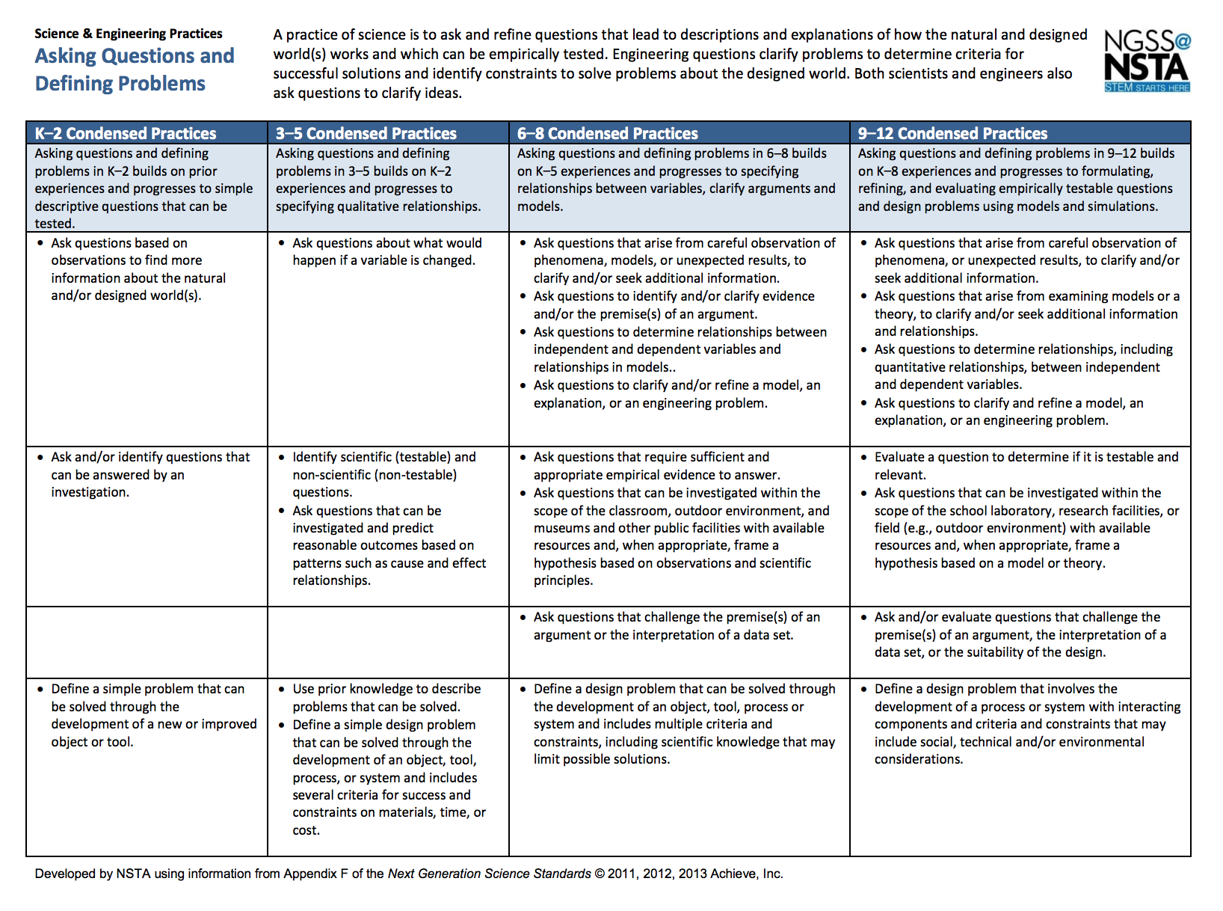
Science and Engineering Practice:
Asking Questions and Defining Problems
Asking Questions/Discussion

Slide 32
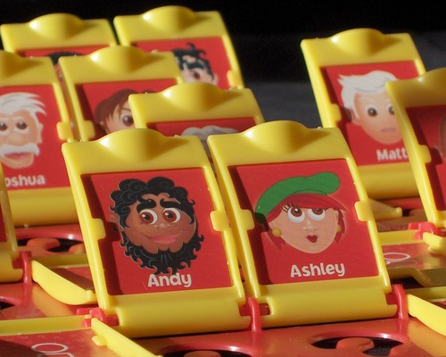

Guess Who?
Asking Questions/Discussion
Notes:
Guess Who/Heads Up game
Adjectives and asking questions
Sentence frames

Slide 33



Group Rules/Protocols
Be respectful of everyone’s opinions
Listen to your group members
Participate!

Slide 34


“Asking Questions that arise from
careful observations”
Observations
Questions
Asking Questions/Discussion
Notes:
Oobleck

Slide 35
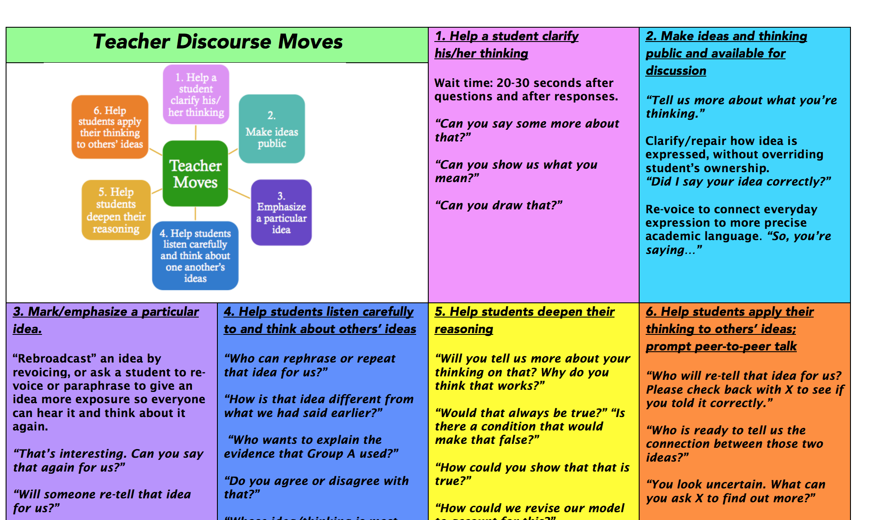
Asking Questions/Discussion
Notes:
Oobleck - making observations
science discourse
teacher moves

Slide 36
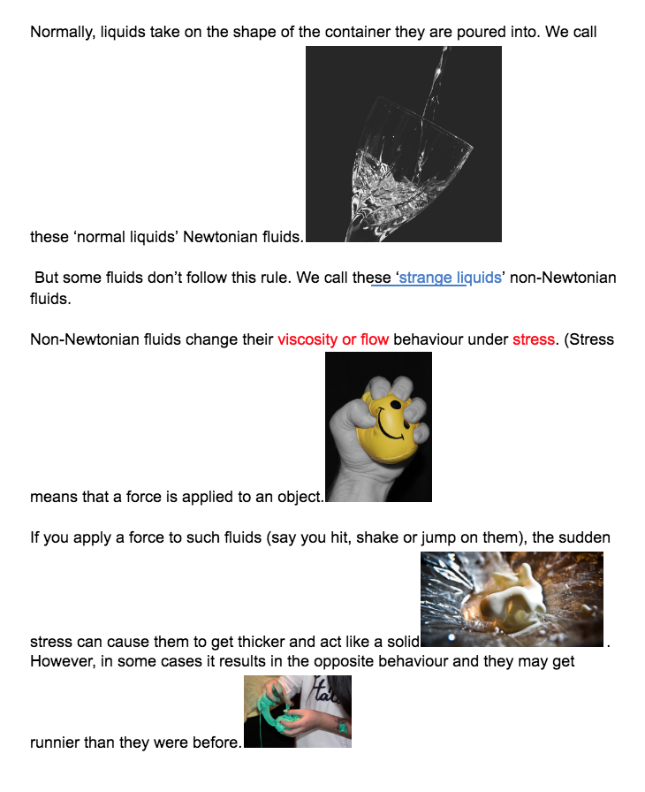

Adapted Text
Asking Questions/Discussion

Slide 37
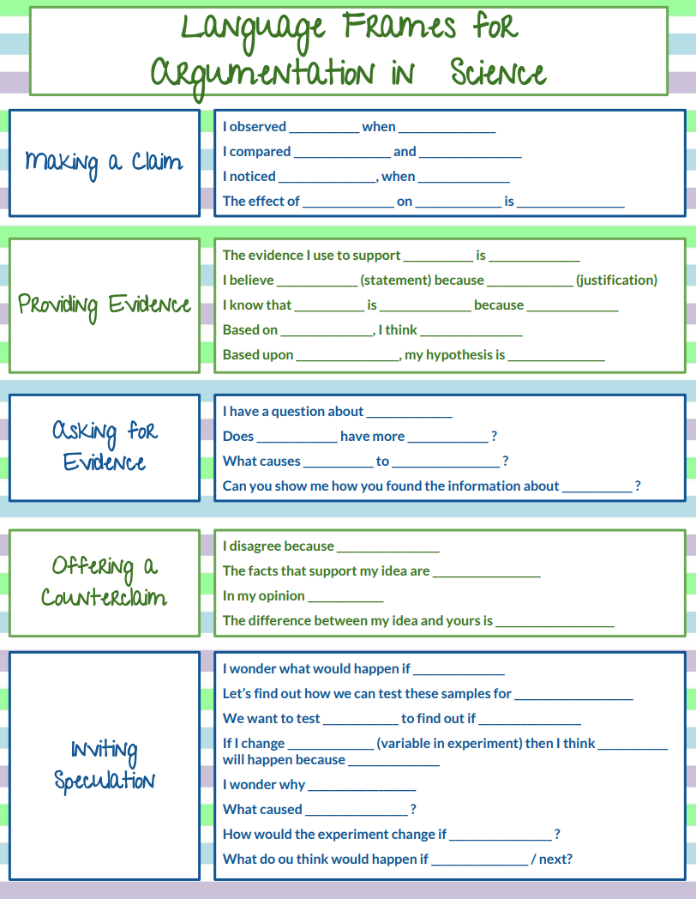
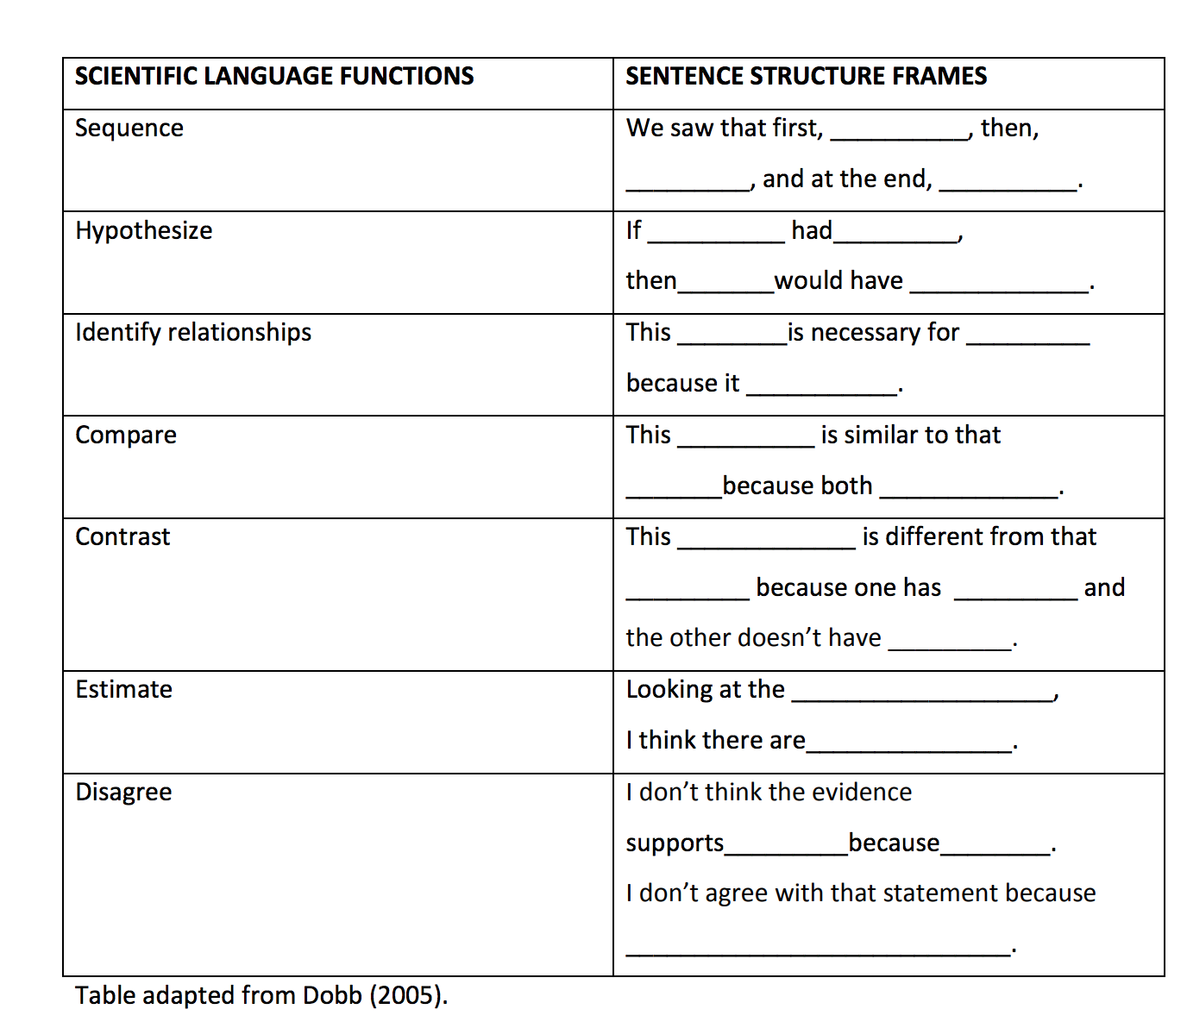
Science Sentence Language Frames
Asking Questions/Discussion
Notes:
https://files.eric.ed.gov/fulltext/ED566950.pdf
Teachers Pay Teachers:

Slide 38
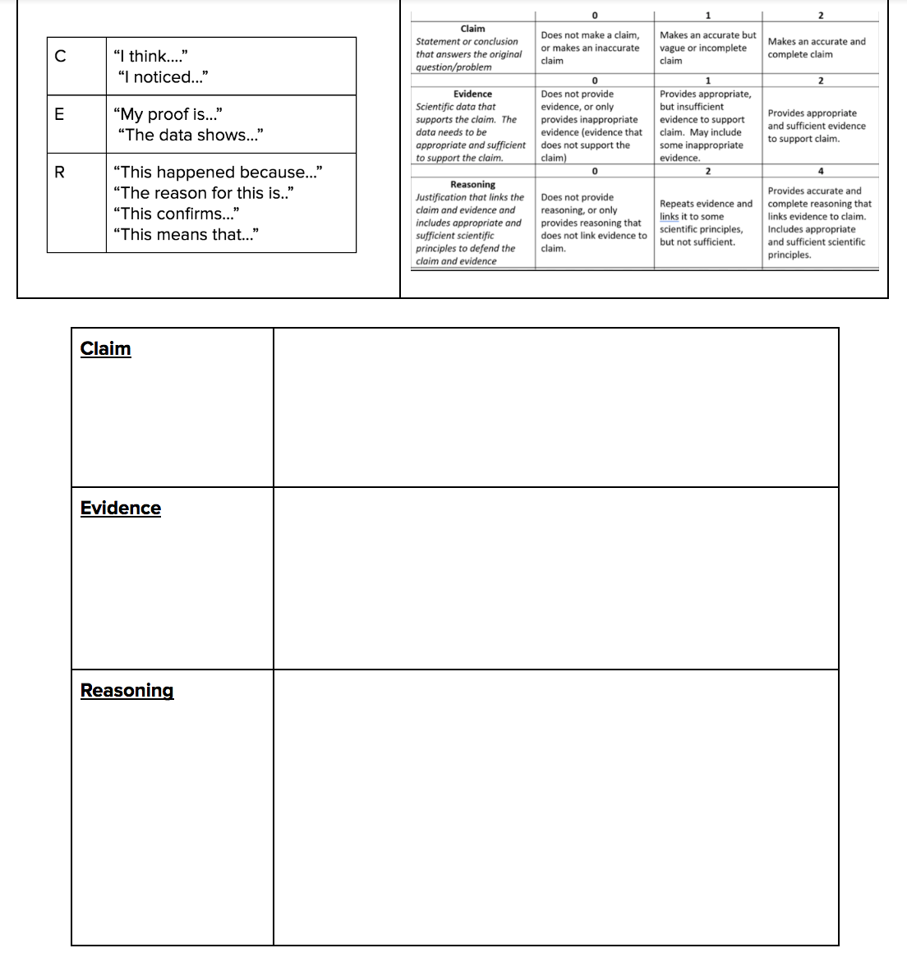
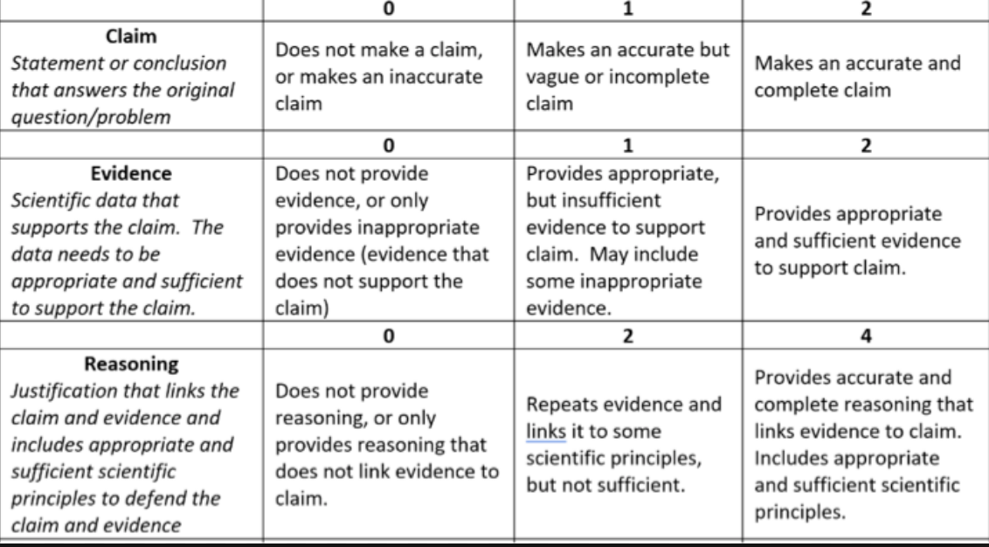
Asking Questions/Discussion
Notes:
CER and Rubric
examples from student notebooks

Slide 39
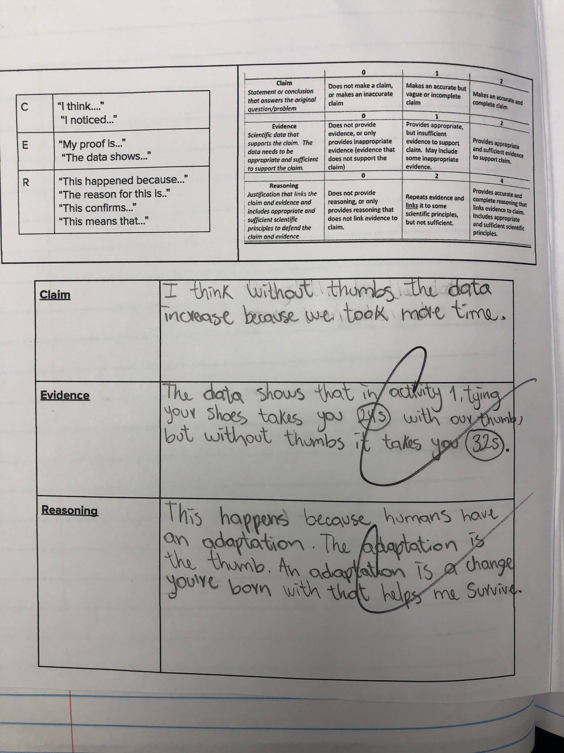
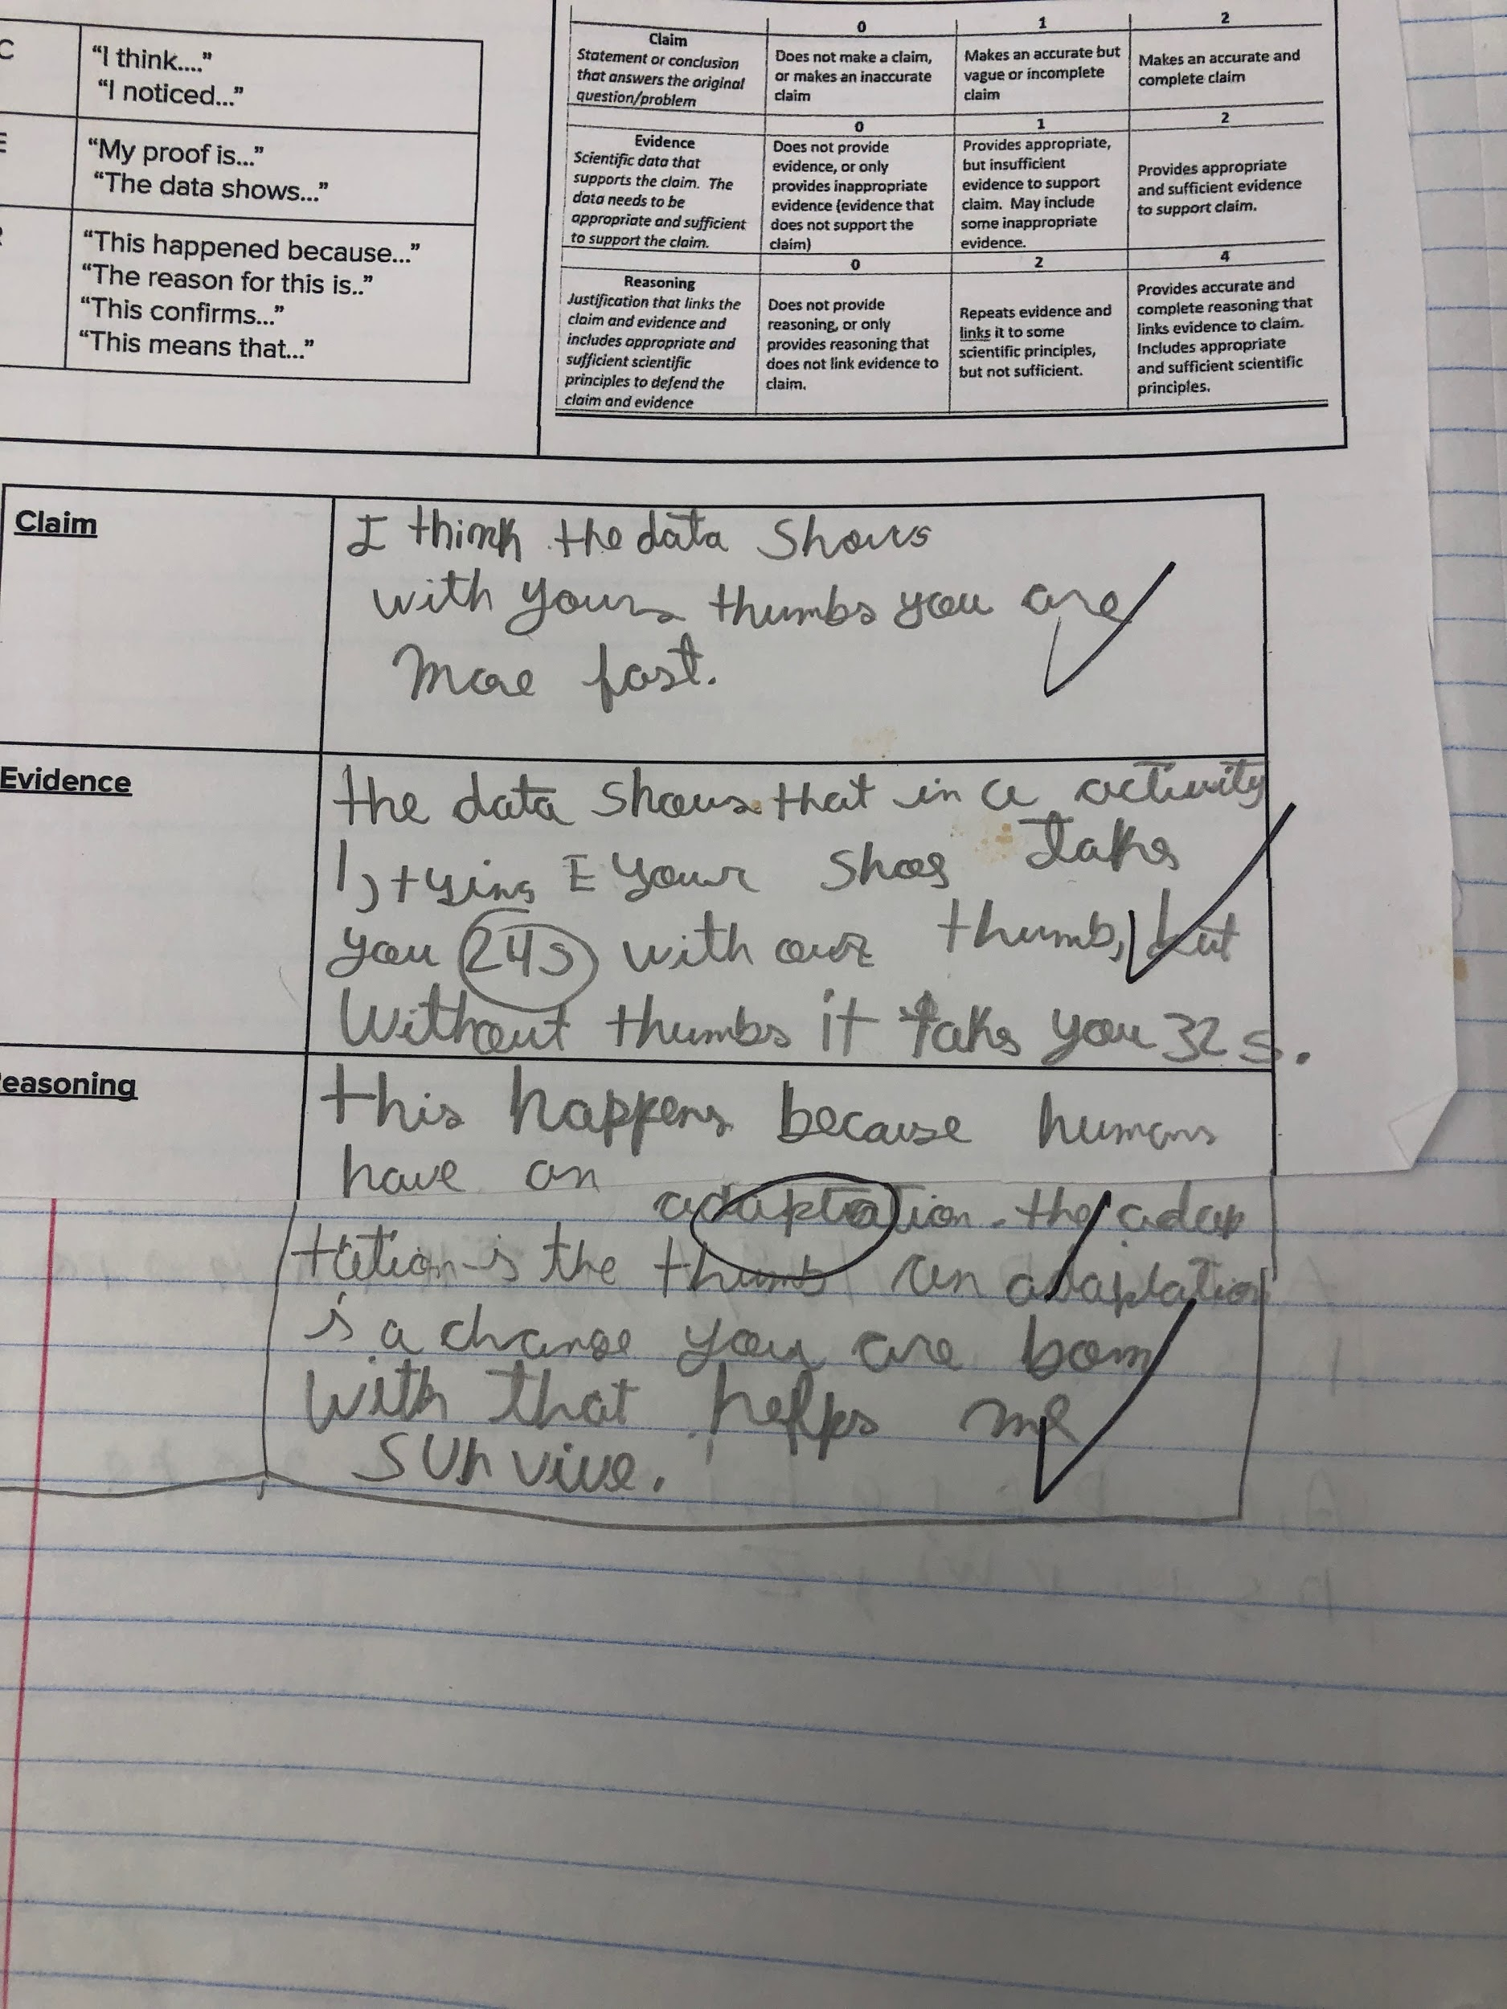
Asking Questions/Discussion

Slide 40
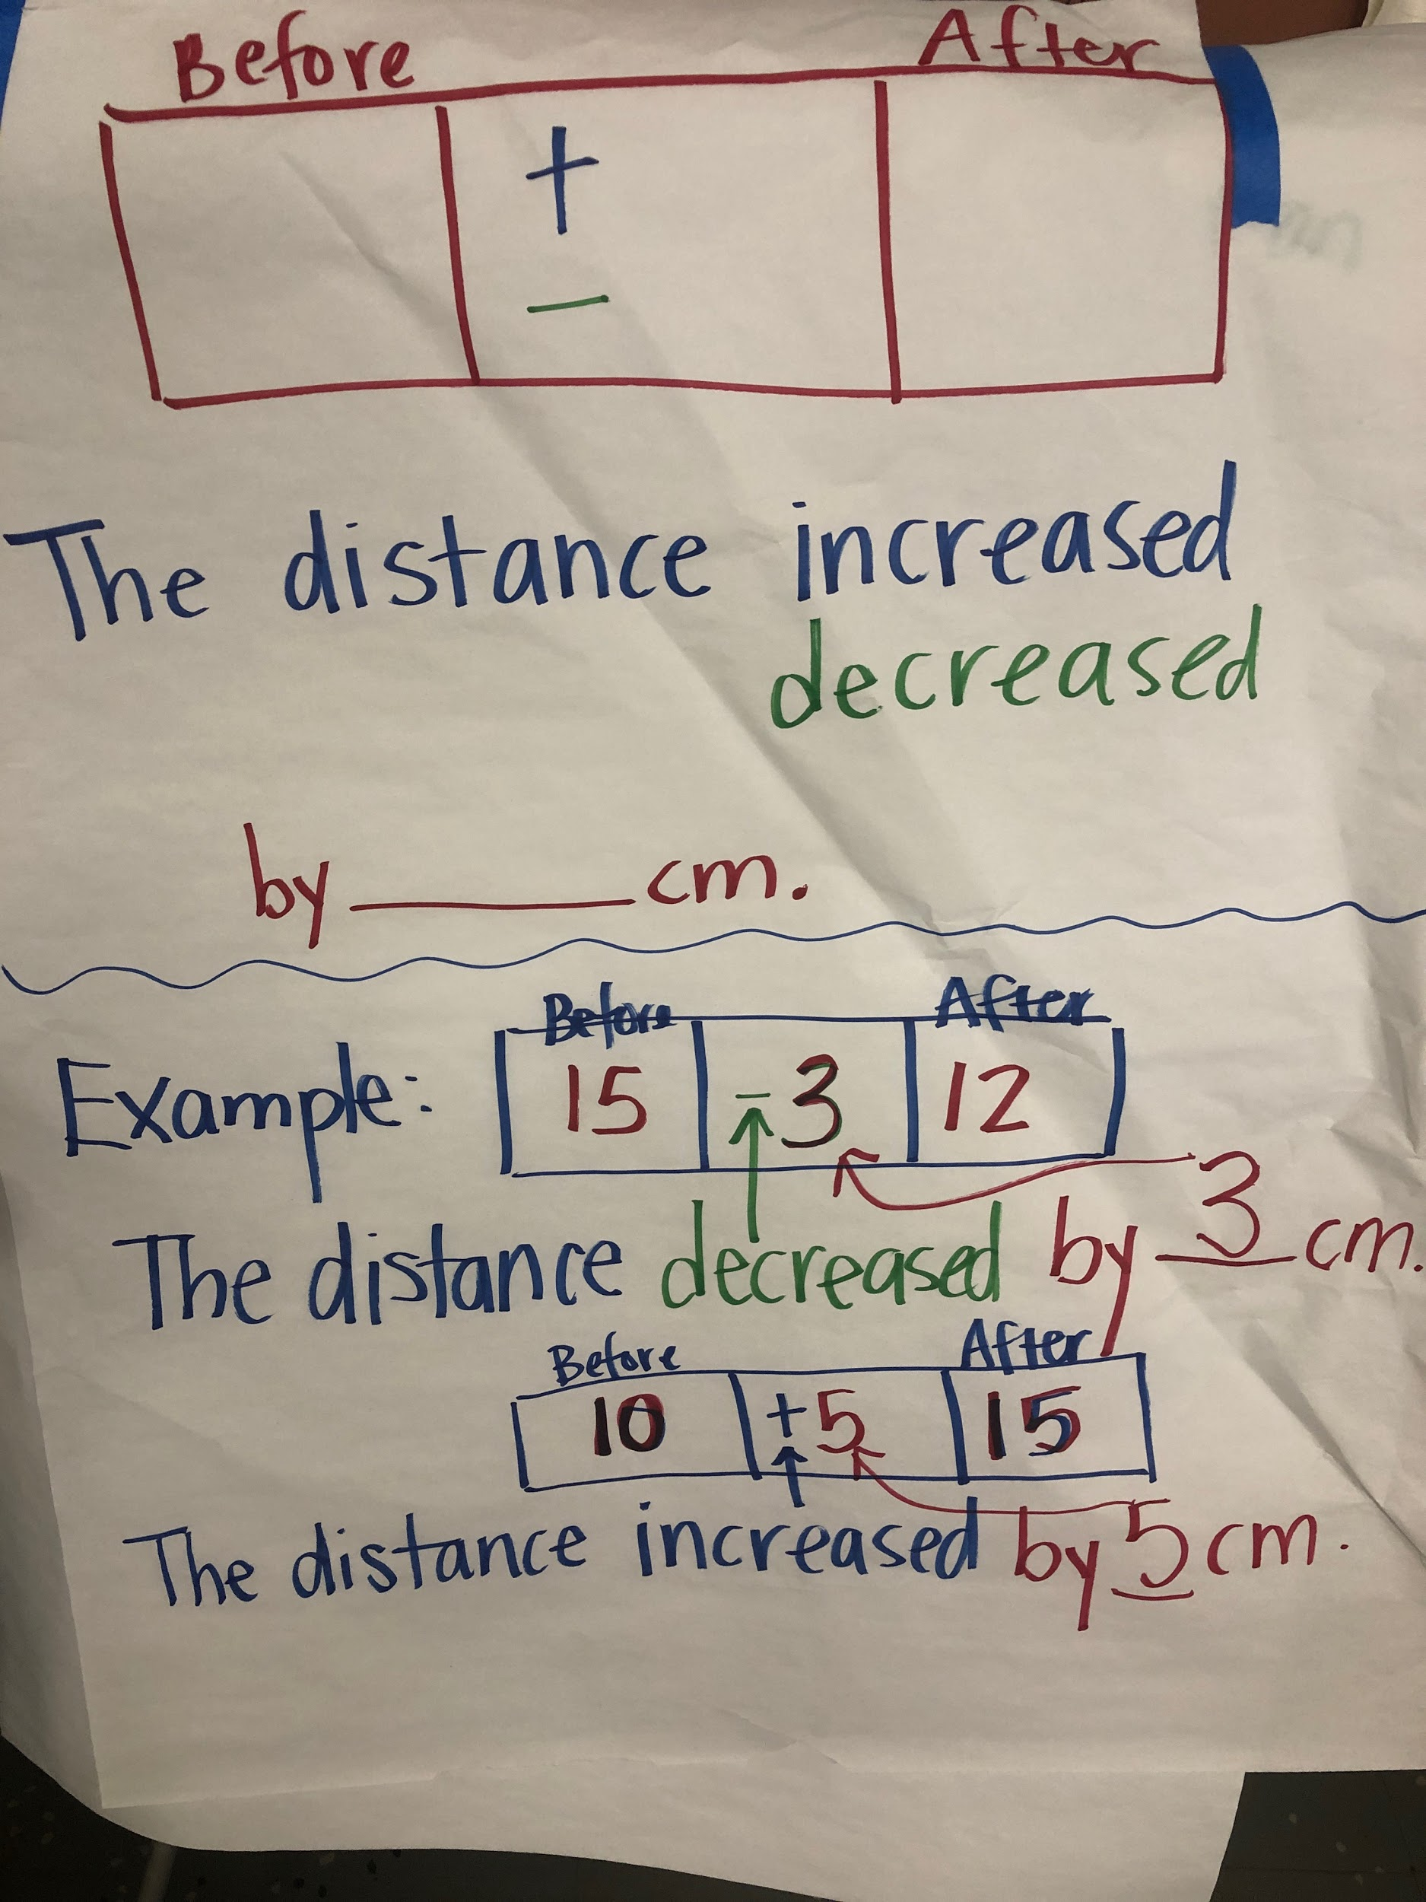
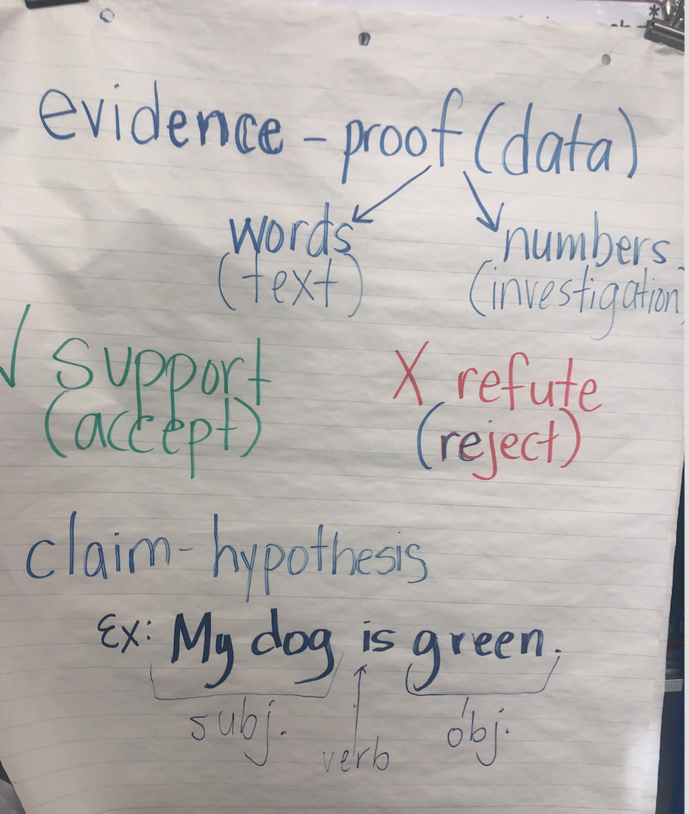
Instructional Supports:
Anchor Charts
Asking Questions/Discussion
Notes:
Supports provided for students

Slide 41
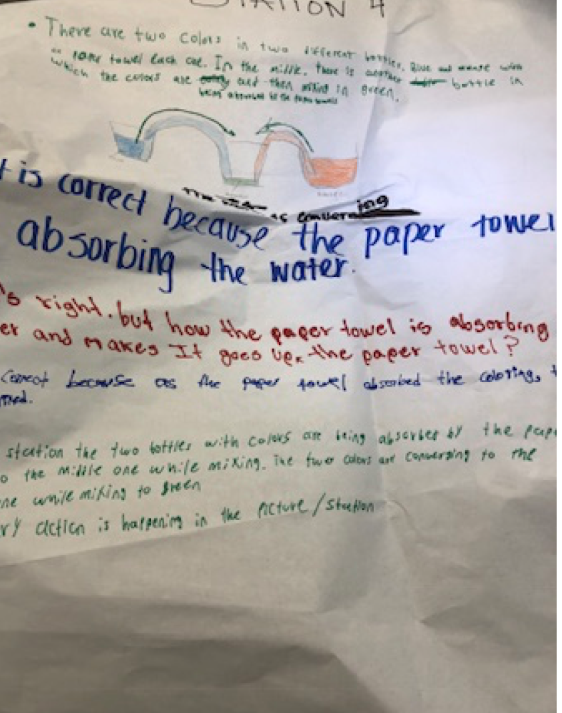
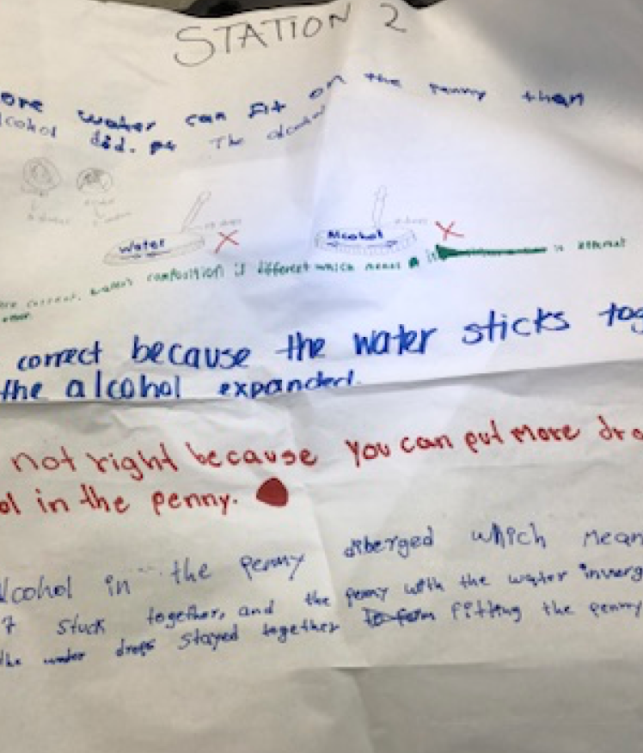
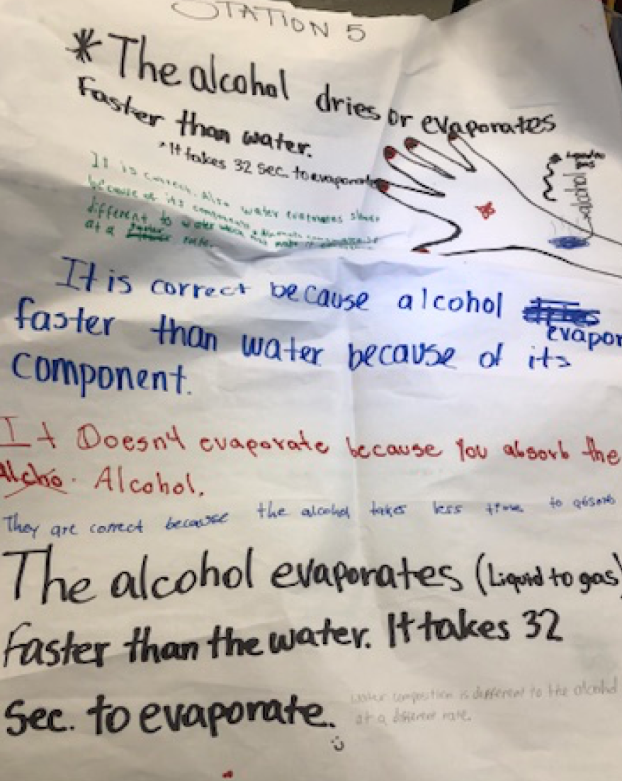
Asking Questions/Discussion
Notes:
Examples of student discussions/observations and questioning

Slide 42
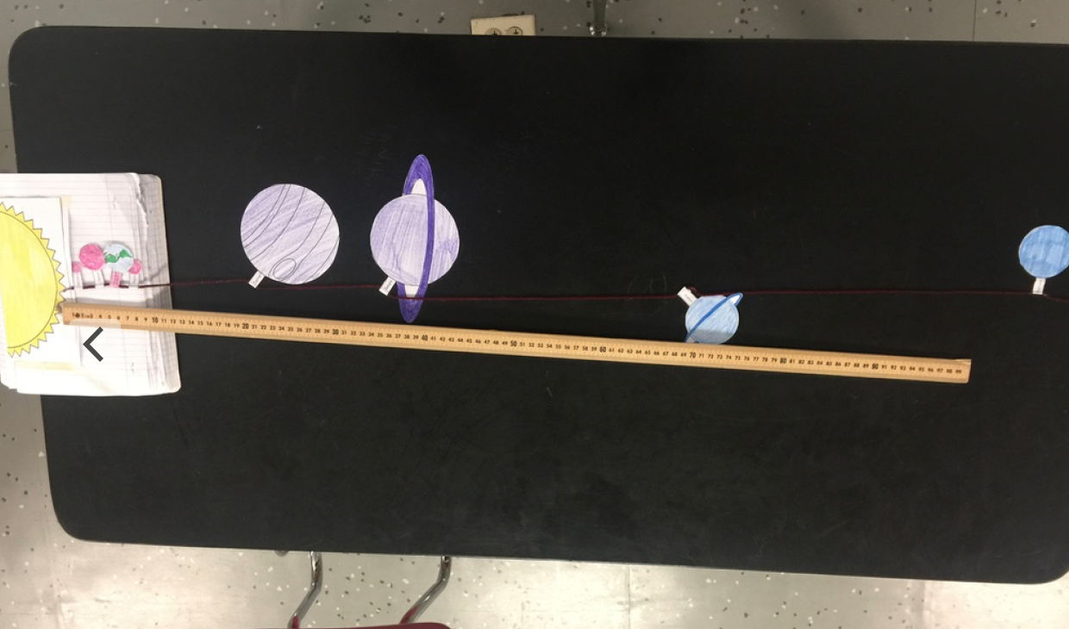
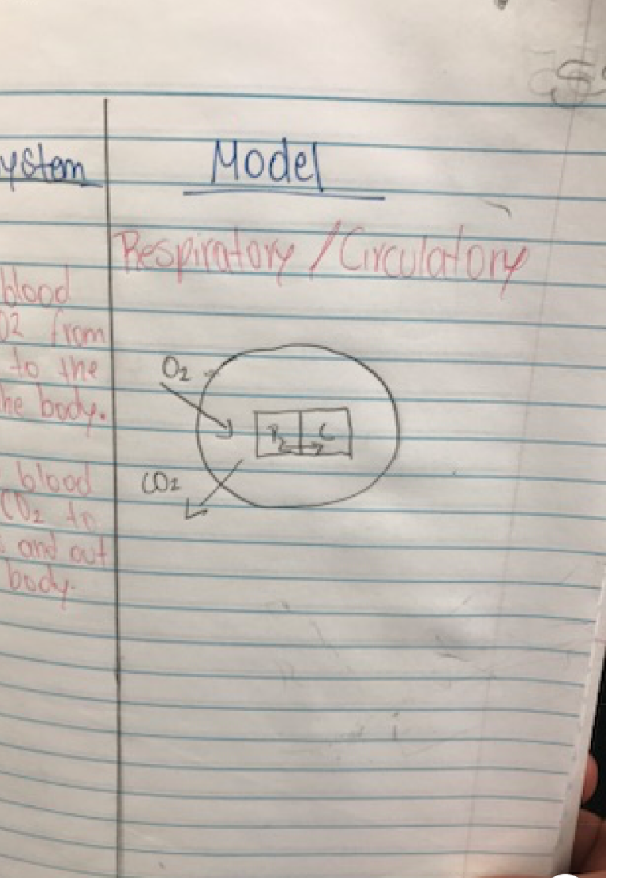
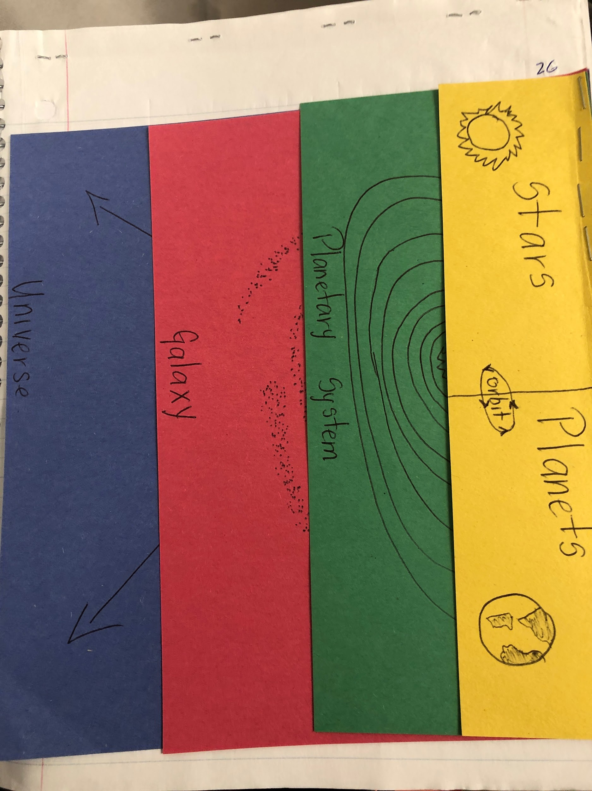
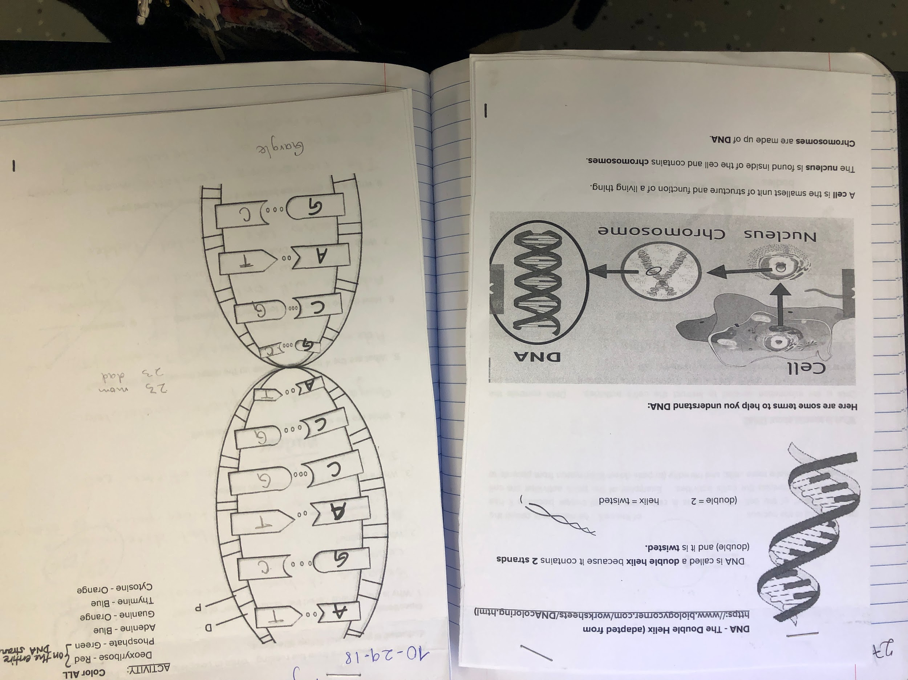
Instructional Supports:
Interactive Science Notebooks
Asking Questions/Discussion
Notes:
Have samples of science notebooks

Slide 43
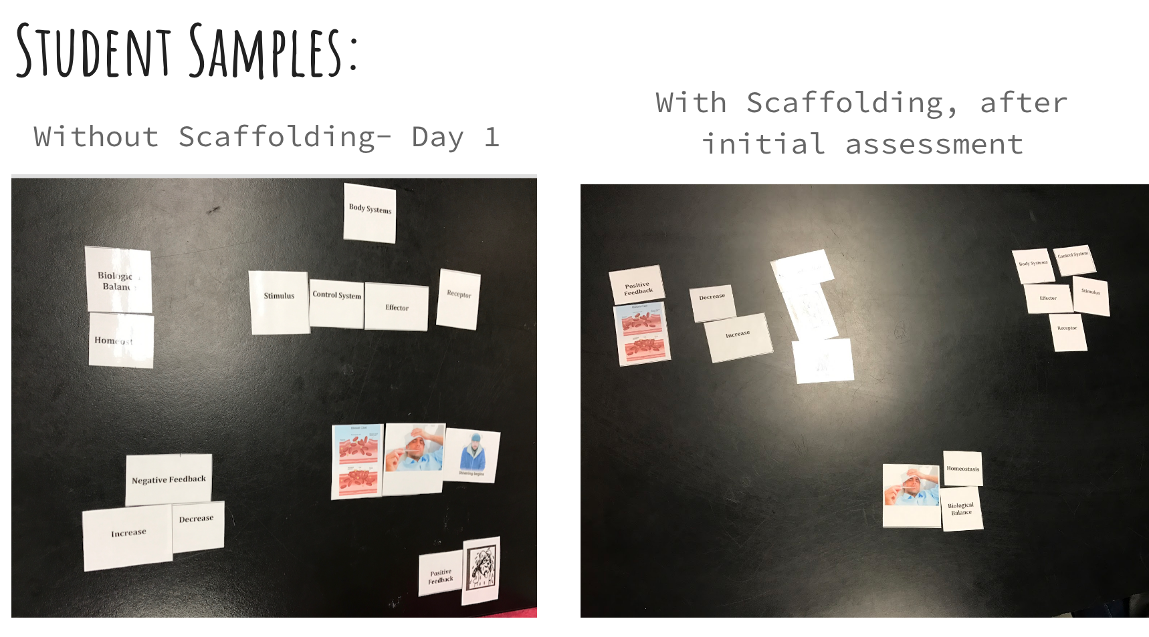
Card Sorts : Allows for meaningful discussion about content and helps check for student understanding
Checking for Understanding
Notes:
Card sorts as formative assessments
Venn Diagrams
Sequence cards

Slide 44
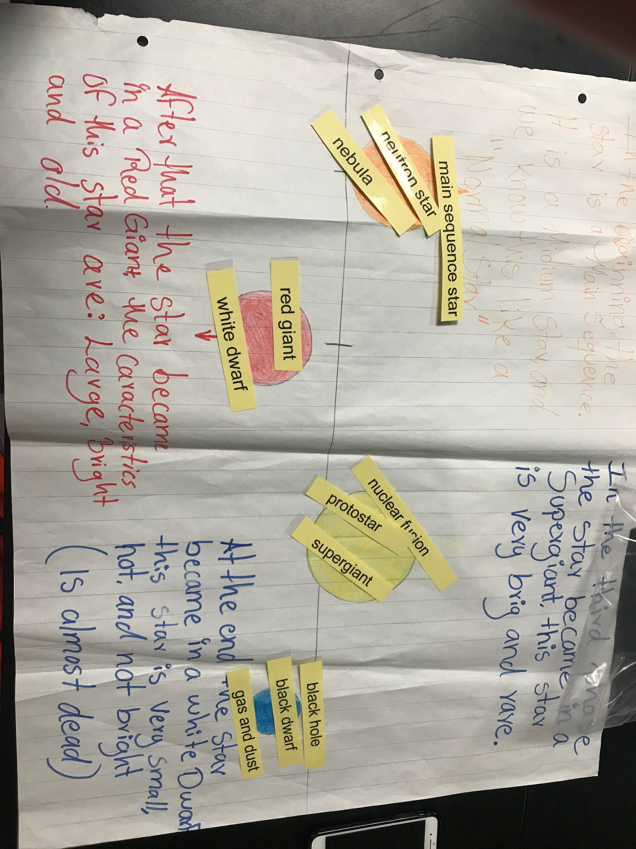
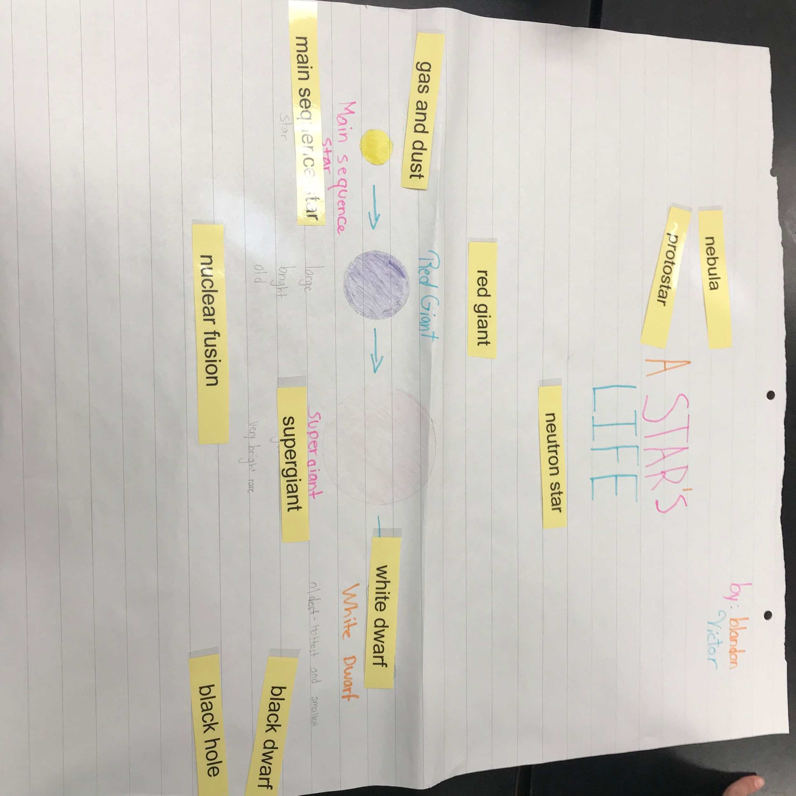
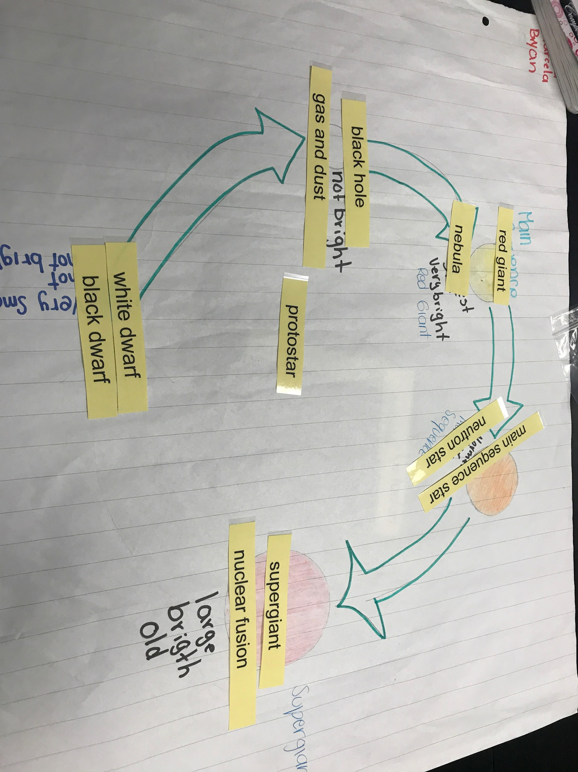
Card Sorts
Checking for Understanding
Notes:
population card sorts

Slide 45

4 Corners: an interactive strategy that promotes listening, verbal communication, cooperation, critical thinking, and decision-making
How?
Ask the students a question and assign an answer choice for each corner of the room.
Allow student time to think and write their answers privately.
Ask the students to walk to a corner based on their answer.
Ask the students to find a partner (at their corner). Each pair will take turns explaining their reasoning to each other.
Students will share their reasoning to the entire class.
Checking for Understanding

Slide 46
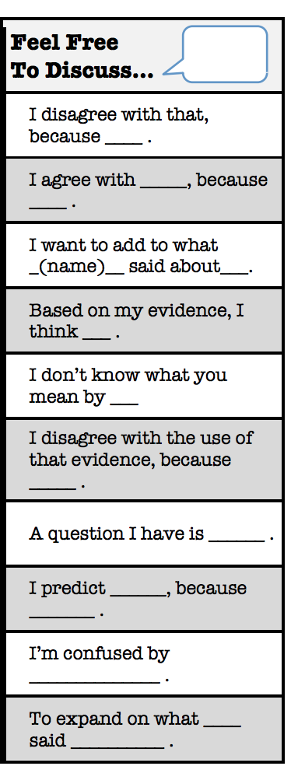
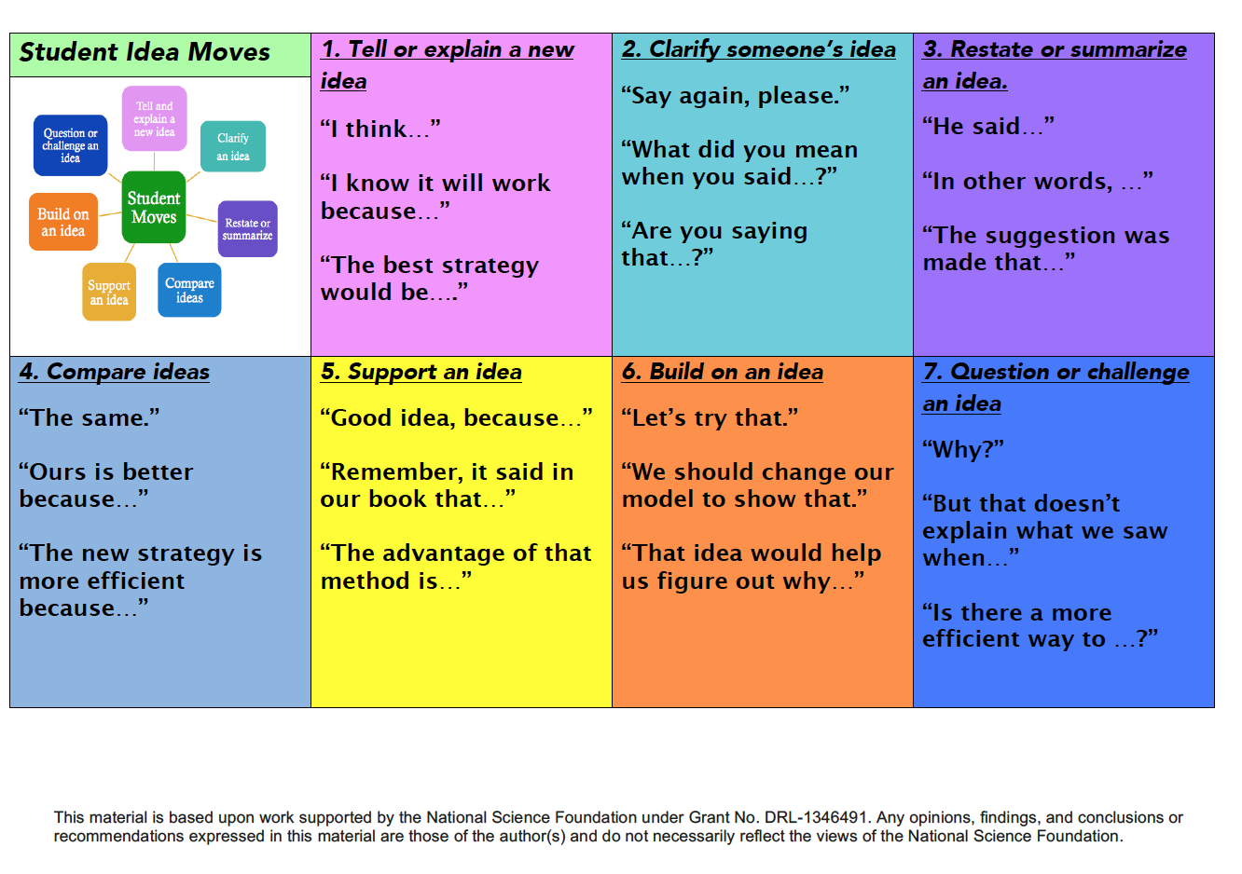
Student Idea moves/Accountable talk

Slide 47

Checking for Understanding

Slide 48


3….2…..1…. Z chart
Checking for Understanding
Notes:
3, 2, 1 - 3 things you know, 2 questions you have, 1 picture

Slide 49



Modified Reading/Scientific Article
“Defusing Africa's Killer Lakes”
By Kevin Krajick Smithsonian Magazine, September 2003
Reading & Writing
Notes:
Phenomenon: Carbon Cycle
Modified: https://docs.google.com/presentation/d/1Es5i5TGl4hPG6-WCsu3yIsfmtKIrQ0DfWD1nlLD_g8E/edit?usp=sharing

Slide 50



Modified Reading/Scientific Article
“Defusing Africa's Killer Lakes”
By Kevin Krajick Smithsonian Magazine, September 2003
Reading & Writing
Notes:
Phenomenon: Carbon Cycle
Modified: https://docs.google.com/presentation/d/1Es5i5TGl4hPG6-WCsu3yIsfmtKIrQ0DfWD1nlLD_g8E/edit?usp=sharing

Slide 51


Reading & Writing

Slide 52

What can teachers do?
Notes:
Video - have a connection with other teachers

Slide 53




School Community & District Support:
District Wide Initiative
Notes:
samples of laminated rings with how to ask a question, sentence strips, etc.

Slide 54

What do you want to tell teachers?
Notes:
Exited Students

Slide 55

What advice would you give yourself ?

Slide 56
Resources:
Strategies
Go To Strategies
Gallery Walk Video
Linguistic Scaffolding Strategies
3..2..1
Templates/Language Frames/Actions
Science Formative Assessments
Science: Language Frame
Z-Chart
Materials
Chalk Markers
Quizlet
www.learnersdictionary.com
Articles
Language Objectives
Asking Questions
I do not own the rights to the pictures or organizers. Please look at the links in order to go to the appropriate webpages.

Slide 57


